Slide 1

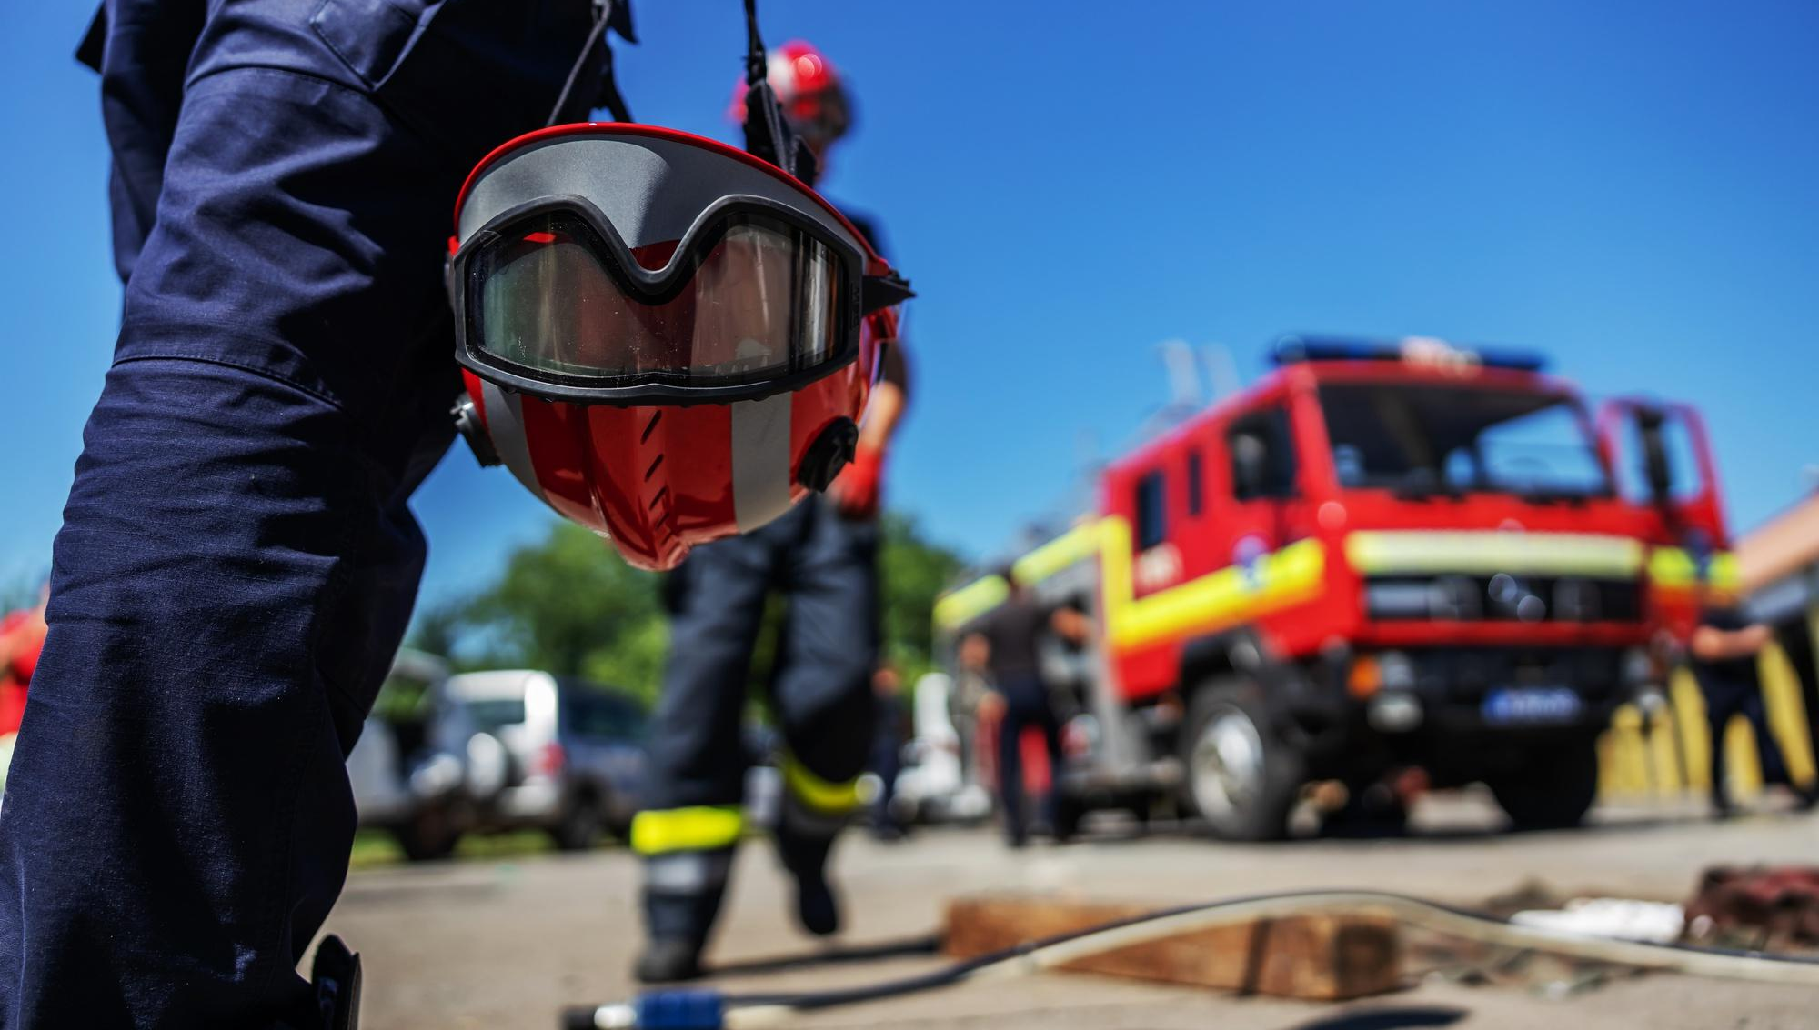


FIRE FIGHTING
Presented By:- Sachin Chauhan,2IC
PEER | CSSR | INDIA
PPT 2 -

Slide 2
OBJECTIVES
1
  What is fire and Type.
  Fire fighting technique.
  Types of Combustion, Mode of spread of fire and Stages & Phases of burning.
Upon completing of this lesson, you will be able to :-
2
3

Slide 3
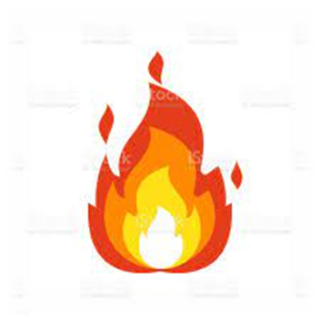
FIRE
A process in which substances combine chemically with oxygen from the air and typically give out bright light, heat and smoke.
Fuel+O2 CO2 + CO

Slide 4
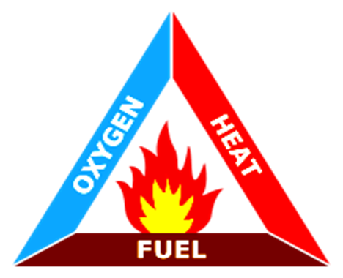

“Three things must be present at the same time to produce fire”
Enough OXYGEN to sustain combustion.
Enough HEAT to reach ignition temperature.
Some FUEL or combustible material.
Together, they produce a CHEMICAL REACTION that results in what we term a “FIRE”.
FIRE AND ITS ELEMENTS: FIRE TRIANGLE

Slide 5
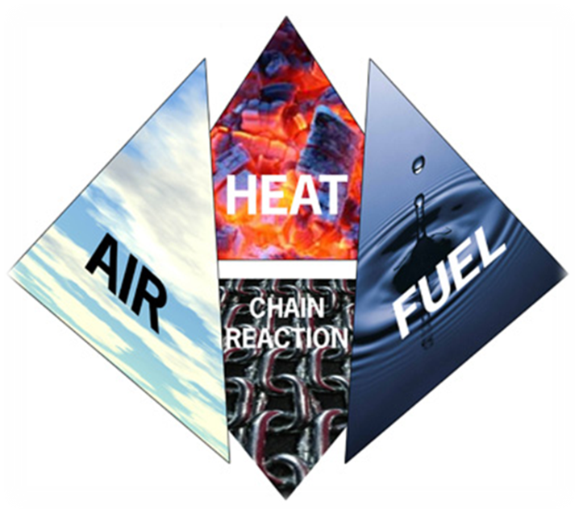
For combustion to occur, four components are necessary:
    Heat (Source)
    Fuel
    Air (Oxygen)
    Self Sustaining Chemical Chain Reaction
FIRE TETRAHEDRON
A triangular shape similar to a pyramid but has 3 sides and a base.

Slide 6
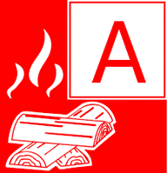
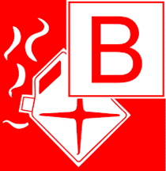
Class A :
        Fire involving solid combustible materials of organic nature such wood, paper, rubber, plastic, cloth which requires cooling effect.
Class B :
        Fire involving inflammable liquids or liquefiable solids such as petrol, kerosene, acids, solvent etc.
CLASSIFICATION
OF FIRE

Slide 7
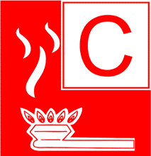

Class C :
        Fire involving inflammable gases under pressure including liquefied gases such as methane, hydrogen, acetylene, LPG etc.
Class D :
        Fire involving combustible metals, such as magnesium, zinc, sodium, aluminum, potassium, radioactive material etc. When the burning metals are reactive to water.
CLASSIFICATION
OF FIRE

Slide 8
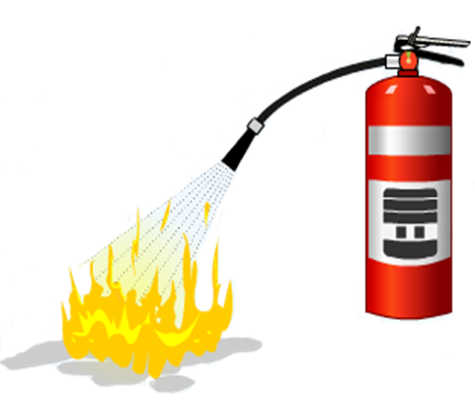
Extinguishing fire involve the elimination or removal of one or more of the four elements
COOLING:
Removal of heat from the burning material/fire area.
FIRE EXTINGUISHING TECHNIQUE:

Slide 9
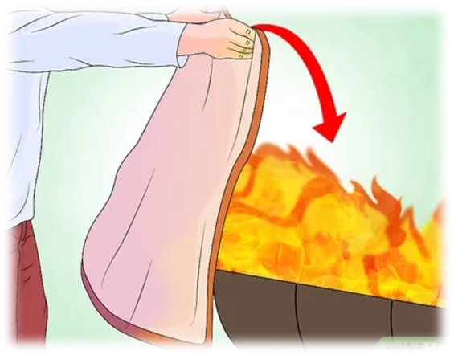
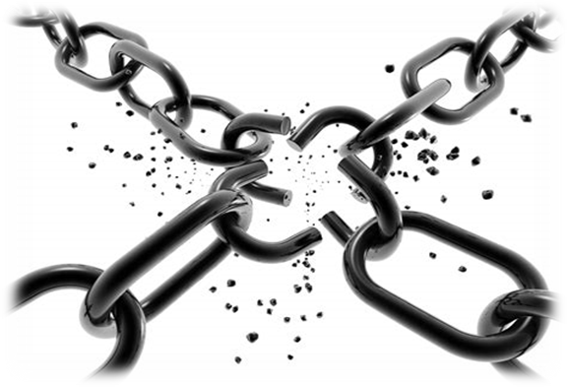
2. SMOOTHERING:
Cutting the supply of oxygen from the fire area.
3. STARVATION:
Removal of un-burnt material or fuel.
4. BREAKING OF CHAIN REACTION:
Interrupt the chain reaction between fuel, heat and oxygen.
FIRE EXTINGUISHING TECHNIQUE:

Slide 10
      Slow or incipient combustion- in which the amount of heat & light emitted is feeble.
      Rapid or active combustion- in which a considerable amount of heat & light is emitted within a short time
TYPES OF COMBUSTION :

Slide 11
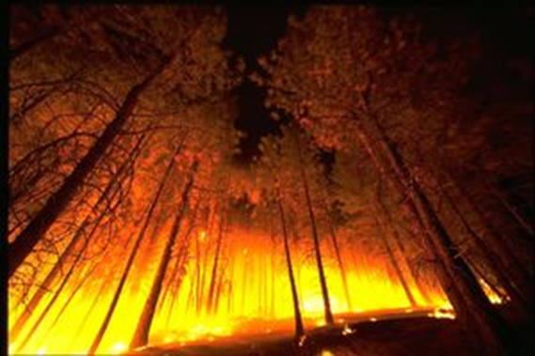
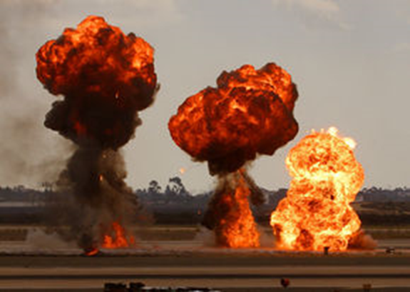
  Deflagration – which takes place with a considerable rapidity, evolving heat & light.
  Explosion - a very rapid combustion with a loud noise within an extremely short time with generation of very high pressure & temperature.
TYPES OF COMBUSTION :

Slide 12
It is the rate of burning of any substance and measured in length over time like millimeters per sec.
A rate of combustion or the spread of fire would depends on :
The area of solid/liquid in contact with air.
The amount of heat generated to raise the temperature of un-burnt portion.
RATE OF COMBUSTION

Slide 13
The ability of materials to conduct heat away.
Atmospheric humidity.
Wind velocity.
Temperature.
Atmospheric pressure.
RATE OF COMBUSTION

Slide 14
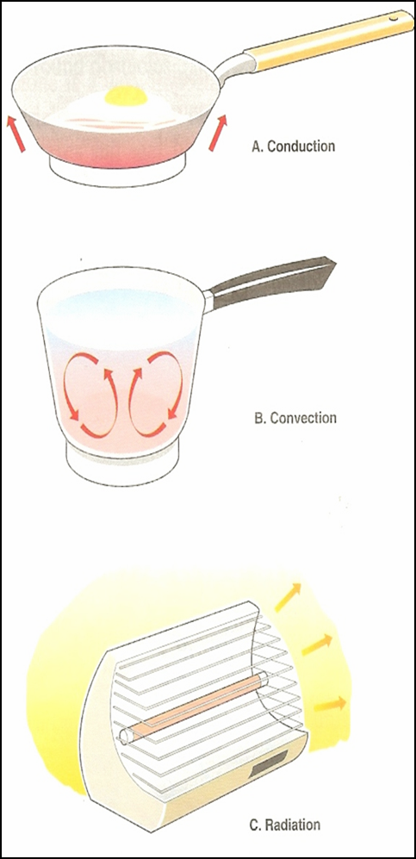
Conduction:
The process by which heat is directly transmitted through the material of a substance when there is a difference of temp bet adjoining regions.
  It occurs only in solids i.e. metallic objects.
MODES OF SPREAD OF FIRE

Slide 15

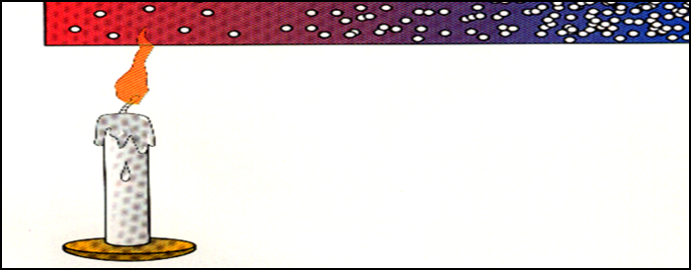
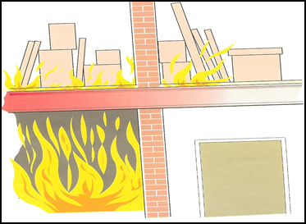
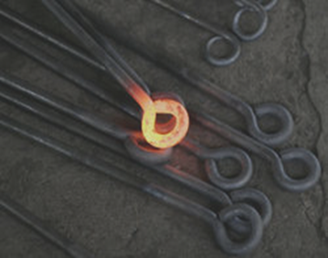
Heat energy is passed on from one molecule to the next.
The molecule vibrates above its mean position.
Pass on heat energy by colliding with their neighbors.
The ability to conduct heat varies between materials.
Less Agitated
CONDUCTION

Slide 16
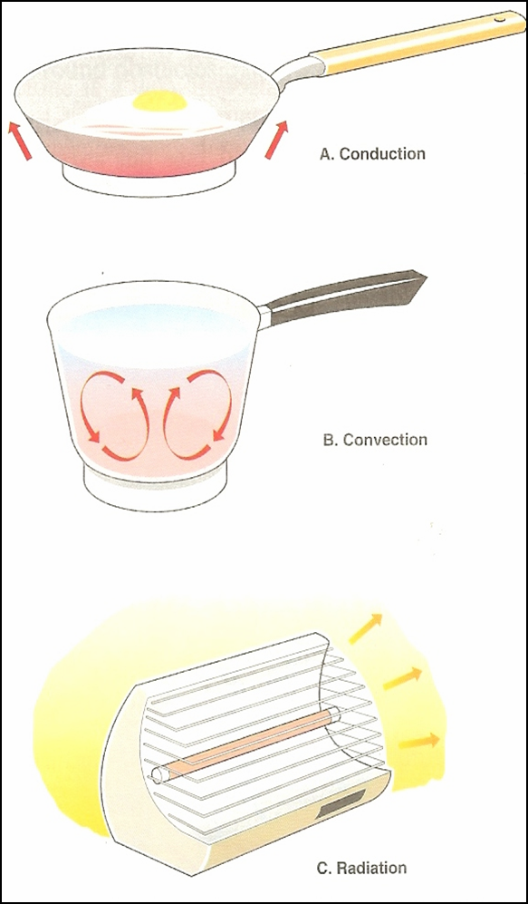
  Transfer of heat by the movement of a fluid (liquid) or gas bet areas of different temp.
  It occurs both in liquids & gases
CONVECTION

Slide 17
  It is neither conduction nor convection. These are heated rays emanating from the hot object.
  It travels at the speed of light.
RADIATION

Slide 18
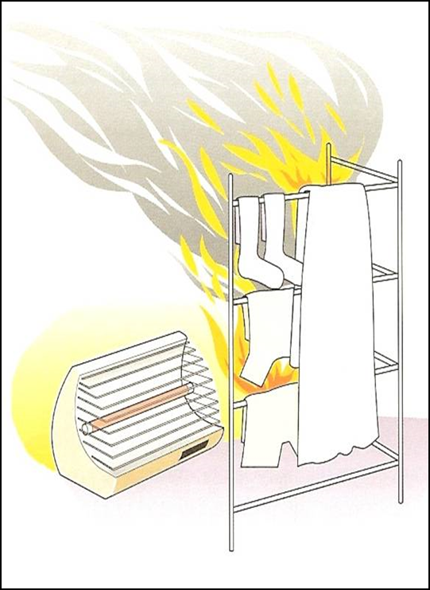
It does not involved any contact between bodies
It is independent of any material in the intervening space
These are the heated rays, travels in straight line in all directions with same intensity
RADIATION

Slide 19
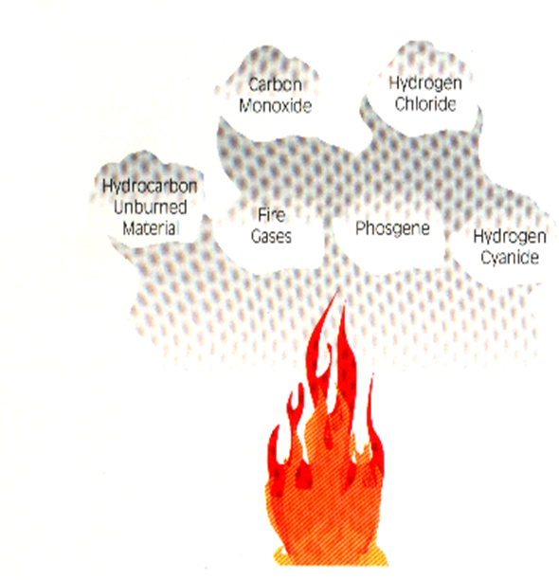
Incipient or beginning phase
Free burning phase
Smoldering phase
THREE PROGRESSIVES STAGES OF BURNING
The products of combustion

Slide 20
It depends on the following factors-
  The amount of time the fire has burnt.
  The ventilation characteristics of the confining structure
  The amount and type of combustibles present.
PHASES OF BURNING

Slide 21
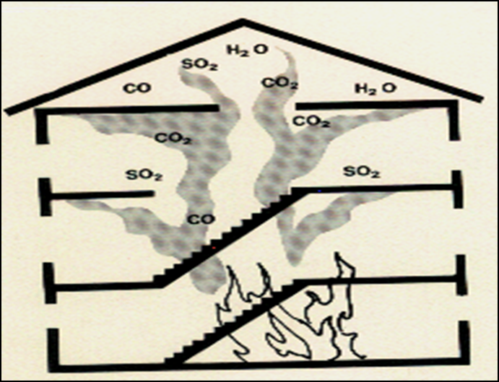
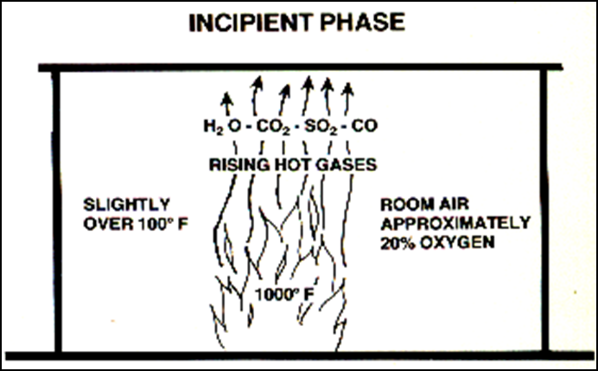
Oxygen plentiful
Temperature has not built up to high peak
Thermal updraft rises, accumulates at highest point
Breathing not difficult
Fire extinguishments :
  Direct application of water at base of fire.
INCIPIENT OR BEGINNING PHASE

Slide 22
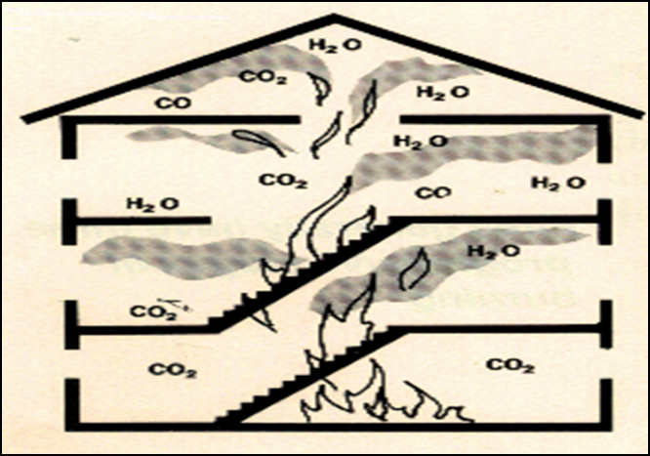
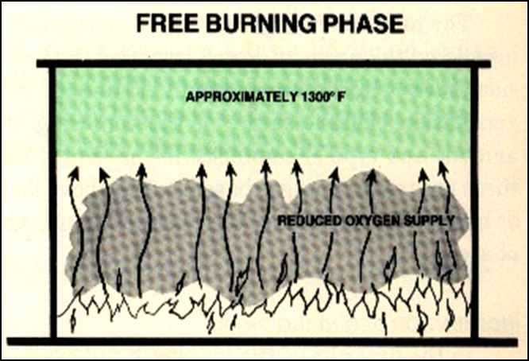
Fire has involved more fuel
Oxygen supply is being depleted
Heat accumulated at upper areas
Breathing difficult : Masks recommended
Fire extinguishments is reaching the area of major involvement
Good steam production
FREE BURNING PHASE

Slide 23
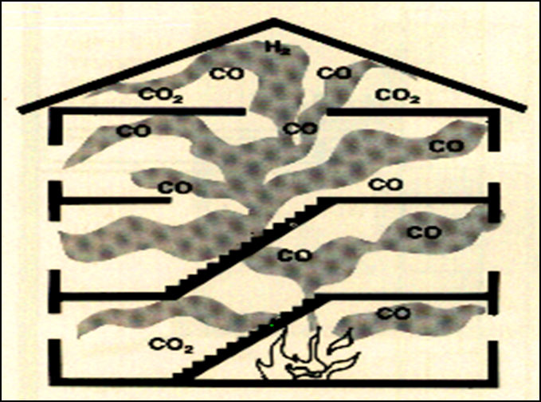
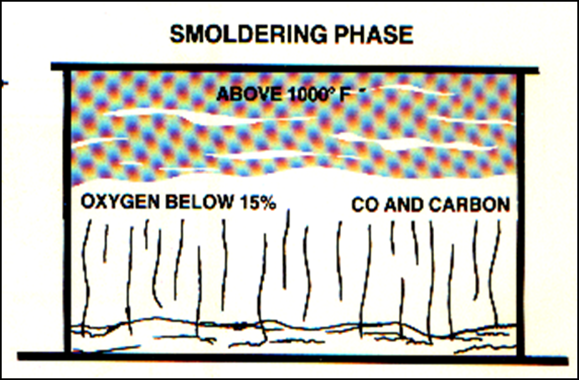
Oxygen supply not equal to demands of fire
Temperature throughout
building is very high
Normal breathing is not possible
Maximum steam production from water fog
SMOLDERING PHASE

Slide 24
  What is fire and Type
  Fire fighting technique
  Types of Combustion, Mode of spread of fire and Stages & Phases of burning
REVIEW

Slide 25

ANY QUESTION ?

Slide 26

1.How many types of fire are there?
Ans- There are four types of the fire, i.e. A,B,C & D types.
2.How many ways are there for fire to spread?
Ans- There are three ways for spread of fire.
Conduction
Convection
Radiation
EVALUATION

Slide 27

THANK YOU

