Slide 1
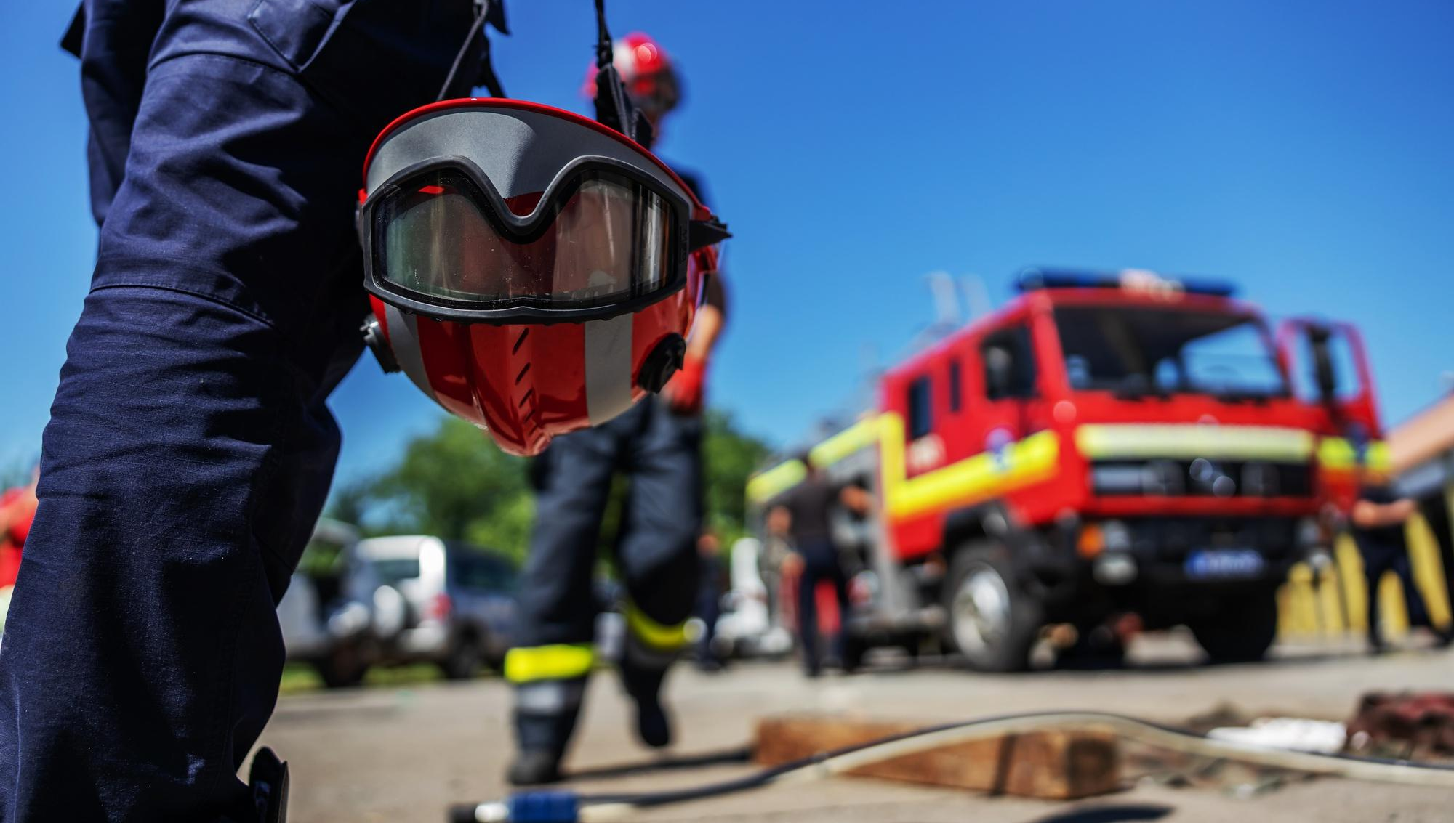



INTRODUCTION OF MOCK DRILL
& EXERCISE
Presented by:- Amit Kumar, AC
PEER | CSSR | INDIA
PPT 2 -

Slide 2
Upon completion of this lecture, you will be able to know about :-
Introduction, Aim & Scope of mock drill exercise.
Steps and types of mock exercise.
Various aspects of the discussed base & operational base exercise.
OBJECTIVE

Slide 3
INTRODUCTION
A Mock drill exercise is an execution part of the already discussed scenario among various government agencies. Department of the disaster exercise, including.
Planning
Pro­cess
Steps for exercise planning
Facilitation
Response
Two categories
1. Discussion-based exer­cises
2. Operations-based exercises

Slide 4
A drill is a coordinated, supervised activity usually employed to test a single, specific operation or function within a single entity
Mock drill
Definition
Mock Exercises, whether in the District, in an industry or in a school, have elicited tremendous response. The state of preparedness gets tested and gaps get identified in resources (manpower or material) communication and systems.
Mock exercises

Slide 5
WHY MOCK DRILL AND EXERCISE?
To test the emergency preparedness level of the school.
To correct the mistakes of various role players of the school.
To avoid misunderstanding of roles and responsibilities.
For better coordination among the teams.
To make it accustomed so as to react instantly.
To check the functioning of the equipment used by disaster response teams.
To test various elements of SDMP and train teachers, school staff, students and others.

Slide 6
AIM OF MOCK DRILL/EXERCISE
To evaluate response.
To improve coordination within departments.
To identify the efficacy of SOPs, policies & capabilities, etc.
To enhance the ability to respond faster.

Slide 7
AIM OF MOCK DRILL/EXERCISE
To make familiar about disaster exercise( in case of disaster rescuers).
To generate Public Awareness by involvement of the Local Government, NGOs and the Public.
Identify the gaps in Resources, Manpower, and communications in any other field.

Slide 8
Scope of Mock Drill/Exercise
To Inculcate a Culture of Preparedness.
To Evaluate the Resource Status of various Departments.
To coordinate the Activities of Various Agencies for their optimum utilization.
To use the Feedback to identify the gaps and improve the Resource Capabilities to Face Actual Disasters.
To review Disaster Management Plan of the State & District department etc.

Slide 9
FACTORS TO BE CONSIDERED FOR MOCK DRILL
To coordinate and supervised.
Clarity on the role and tasks of each facility pacific operation or function.
A Mock Drill is the testing of the efficacy of a Plan.
To evaluate response.
To improve coordination with departments.
To enhance the ability to respond faster.

Slide 10
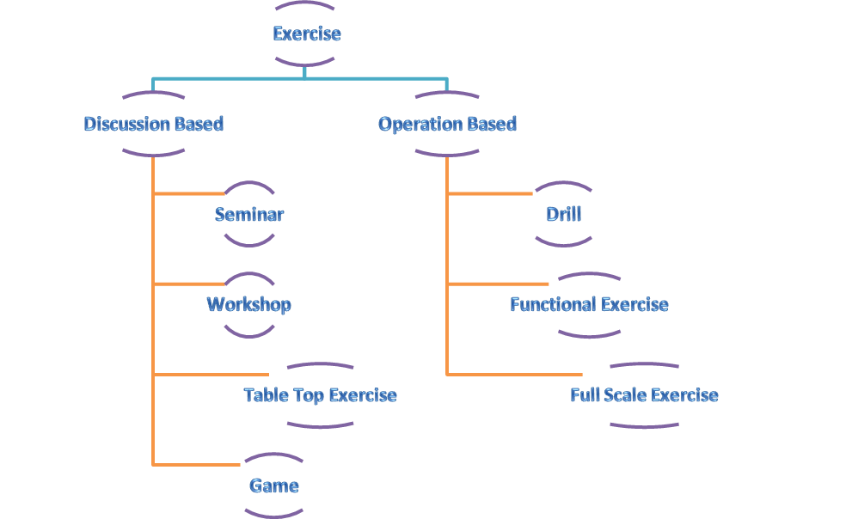
TYPES OF EXERCISE

Slide 11
Discussion-based Exercises typically focus on strategic, policy-oriented issues.
Seminar
workshop
Tabletop Exercise (TTX)
Game
Operations-based Exercises Basically tend to focus more on response-related issues
Drills,
Functional exercises,
Full-scale exercises.
TYPES OF EXERCISE

Slide 12
MOCK EXERCISES IN SCHOOLS
The Mock Exercises in Schools are conducted in two steps:
STEP 1.
It is conducted as a presentation. The School DM Framework, making of the School DM Committee, outline the DM Plan, suggests the School DM team composition and how the Mock Exercise would be conducted are all delineated. A short documentary on School Safety is also shown. The Principal, Vice Principal, selected teachers, prefects, monitors and the school head boy/girl attend the meeting that is usually held in a hall.

Slide 13
STEP-2
In the Mock Exercise, the first responders of the school, such as evacuation teams, SAR teams, first aid teams, etc. are checked for their actions, with the aim of empowering the schools, to face such disasters on their own before the specialist response from the district reaches them.

Slide 14
COMPARING THE GLOBAL MODEL OF EXERCISE
US MODEL:
Orientation Seminar
Workshop
Table-top Exercise
Games
Drills
Functional Exercise
Full-Scale Exercise
AUSTRALIAN MODEL
Seminar
Workshop
Syndicate progressive
Hypothetical
Drills
Functional Exercise
Field Exercise
UK MODEL
Seminar Exercise
Table-top Exercise
Control Post Exercise
Live Exercise
INDIAN MODEL
Coordinating conference
Table top exercise
Mock exercise

Slide 15
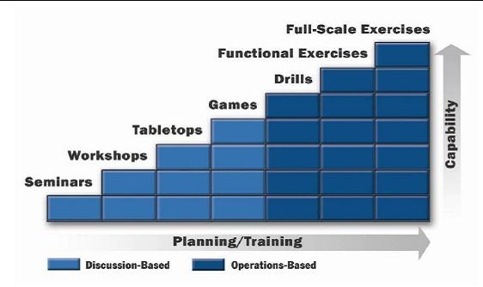
BUILDING BLOCK OF EXERCISE

Slide 16



A seminar is an informal discussion, designed to orient participants to new or updated plans, policies, or procedures
A workshop resembles a seminar, but is employed to build specific products, such as a draft plan or policy.
A tabletop exercise involves key personnel discussing simulated scenarios in an informal setting. TTXs can be used to assess plans, policies, and procedures.

Slide 17
SEMINAR | WORKSHOP | TABLETOP EXERCISE (TTX)
A seminar is an informal discussion | A workshop resembles a seminar | A tabletop exercise involves key participants
Good method for informing and training for any emergency management plan. | Workshop to create a new and improved policy for responding. | TTXs can be used to assess plans, policies, and procedures .
Seminar is more about a meeting relating to education background including training. | Workshop is like a class in which a group of interested people are trained. | Tabletop exercises provide an excellent emergency management plan.
It is a lecture or presentation delivered to an audience on a particular topic . | Workshop practice gives the basic working knowledge. | TTX guide about developing and conducting or execution of an exercise.
Difference Between Seminar, Workshop and Tabletop Exercise

Slide 18
OPERATIONS-BASED EXERCISES
Drill: A drill is a coordinated, supervised activity usually employed to test a single, specific operation or function within a single entity.
Functional exercise: Examines and/or validates the coordination, command, and control between various multi-agency co-ordination Centre.
Full-scale exercise: It is typically a multi agency, multi jurisdictional, multi-discipline exercise involving functional in real-time, real place scenarios.

Slide 19
points to be kept in mind while preparing for table top exercise
Gathering of official staff and key staff.
Group participation.
May be simple or complex.
Resources will not be deploy.
No time pressure.
Require little planning and coordination.

Slide 20
Introduction, Aim & Scope of mock drill exercise.
Steps and types of mock exercise.
Various aspects of discussed base & operational base exercise.
REVIEW

Slide 21
ANY QUESTION

Slide 22


THANK YOU

