Slide 1
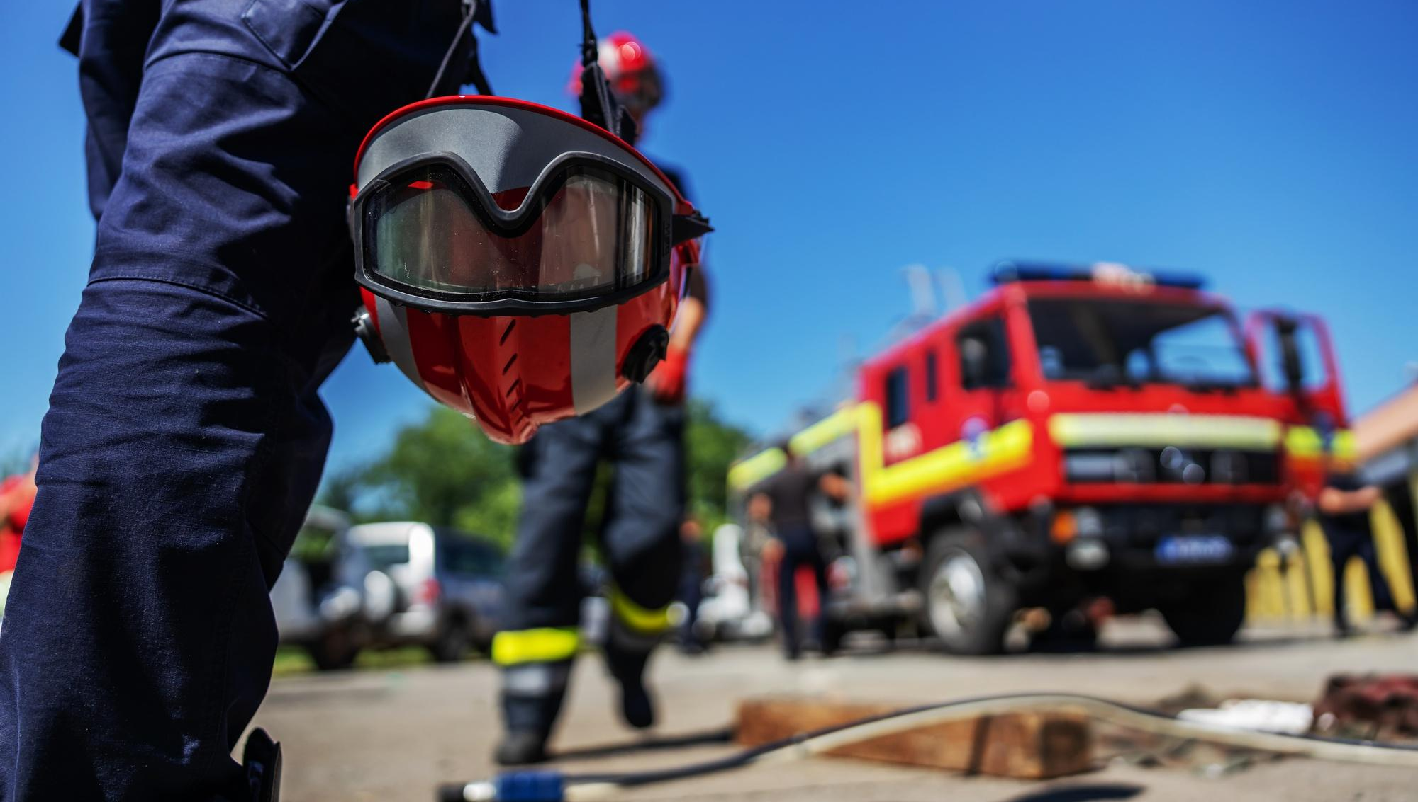



EMERGENCY PREPAREDNESS
Presented By:- Sachin Chauhan,2IC
PEER | CSSR | INDIA
PPT 2 -

Slide 2

OBJECTIVES
Before a wildfire: Preparation and mitigation
During a wildfire: Response and evacuation
After a wildfire: Recovery
1
Upon completing of this lesson, you will be able to :-
2
3

Slide 3
Definition-
Wildfires are a serious threat to communities in forested areas, and being prepared is crucial for protecting lives and property. This guide outlines essential steps for preparing for, responding to, and recovering from a wildfire event.

Slide 4

Creating defensible space around your home
Zone 1 (0-10 meters): Focus on removing highly flammable materials like dead leaves, needles, woodpiles, and dry grass around the house and outbuildings. Consider fire-resistant landscaping with appropriate spacing between plants.
Zone 2 (10-30 meters): Thin out shrubs and trees, focusing on maintaining vertical separation (removing lower branches) to reduce the potential for crown fires.
Zone 3 (30-100 meters and beyond): Reduce the density of vegetation and clear undergrowth to slow down wildfire progression.
Before a wildfire:
Preparation and mitigation

Slide 5


Hardening your home
Roof and siding: Opt for fire-resistant materials like metal, clay tiles, stucco, or brick.
Vents and eaves: Cover vents with ⅛-inch metal mesh and enclose eaves to prevent ember entry.
Decks and fences: Use fire-resistant composite decking or treat wood decks with fire retardant chemicals, and use non-combustible materials for fences connected to the house.
Before
a wildfire:
Preparation and mitigation

Slide 6
Emergency Supply Kit (Go-Kit): Assemble a kit with at least a 3-day supply of non-perishable food, water, medications, first-aid supplies, important documents, flashlights, extra batteries, and a battery-powered radio.
Wildfire Action Plan: Develop a comprehensive plan including:-
  -Evacuation routes: Identify and practice several escape routes from your home and community.
  -Family communication plan: Designate an out-of-area contact person to communicate with if family members get separated.
Before
a wildfire:
Preparation and mitigation

Slide 7
Monitor Conditions: Pay close attention to official advice and warnings.
Evacuate if Advised or Feeling Unsafe: Leave immediately if an evacuation order is issued or you perceive a threat.
Secure your Home Before Leaving (if time and safety permits): Turn off gas and electricity, close windows and doors, move outdoor furniture away from the house, and notify emergency contacts.
During a wildfire:
Response and evacuation

Slide 8
Monitor Conditions: Pay close attention to official advice and warnings.
3. Dress Appropriately: Wear protective clothing like long sleeves, pants, sturdy shoes, and a mask (N95 or higher) to protect against heat and smoke, if conditions permit.
4. Drive Cautiously: Turn on headlights, close windows, turn on inside air and AC, and follow the fastest paved route away from the fire, avoiding fire roads.
5. Seek Safe Refuge if Trapped: If escape routes are blocked, stay in your vehicle or a building, or seek an open area away from vegetation.
During a wildfire:
Response and evacuation

Slide 9
Do Not Return Until Authorized.
Inspect Your Home and Property.
Seek Assistance: Monitor Air Quality:
Address Mental and Emotional Well-being:
Stay Involved and Educated:
After a wildfire: Recovery

Slide 10
Before a wildfire: Preparation and mitigation
During a wildfire: Response and evacuation
After a wildfire: Recovery.
Review

Slide 11

Any question ?

Slide 12

1. How many zones is home security divided into?
Ans- 03 Zones
What is the recommended distance in all 03 zones to protect a home from forest fire?
Ans- 03 Zones
Zones 1- (01 -10 meter)
Zones 2- (10-30 meter)
Zones 3- (30-100 meter)
Evaluation

Slide 13



THANK YOU

