Slide 1




ROAD & HOME SAFETY
Presented by:- Amit Kumar, AC

Slide 2






Slide 3
OBJECTIVE
Upon completion of this lesson, you will be able to…
Describe road safety
List ten points of road safety
Identify Guidelines for transport facilities in school
Describe the ABC of road safety.

Slide 4
OBJECTIVES
Describe the Importance of home safety
Identify hazards in your home
Describe how to minimise recognised hazards
Describe how to keep your home and family safe
and secure.
Notes:
Slide Show Notes
The main objective of this session is to help you ensure that your home is safe. By the time the session is over, you should be able to:
Understand the importance of home safety;
Identify hazards in your home;
Eliminate or minimize recognized hazards; and
Keep your home and your family safe and secure.

Slide 5
Road safety – India’s biggest emerging challenge
A multicultural, multi-religious democracy of more than one billion has 29 official languages.
With its size, population, diversity, urbanisation and motorisation, Road Safety is the biggest emerging challenge.
Notes:
This goes, agenda

Slide 6


Slide 7
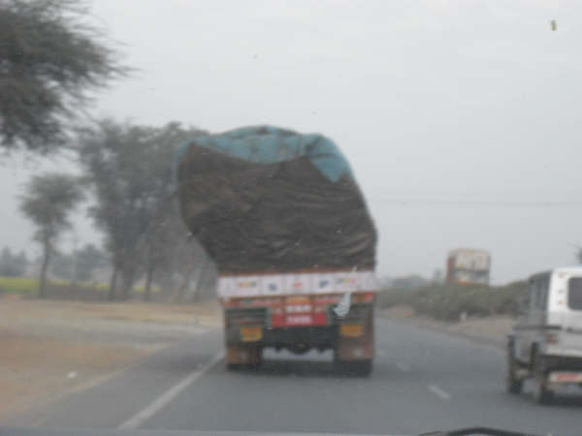
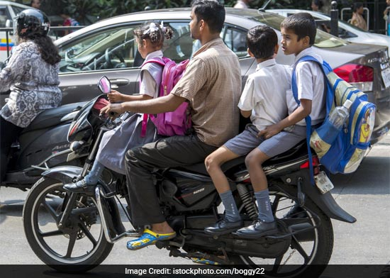
Some contributing factors for road accidents

Slide 8
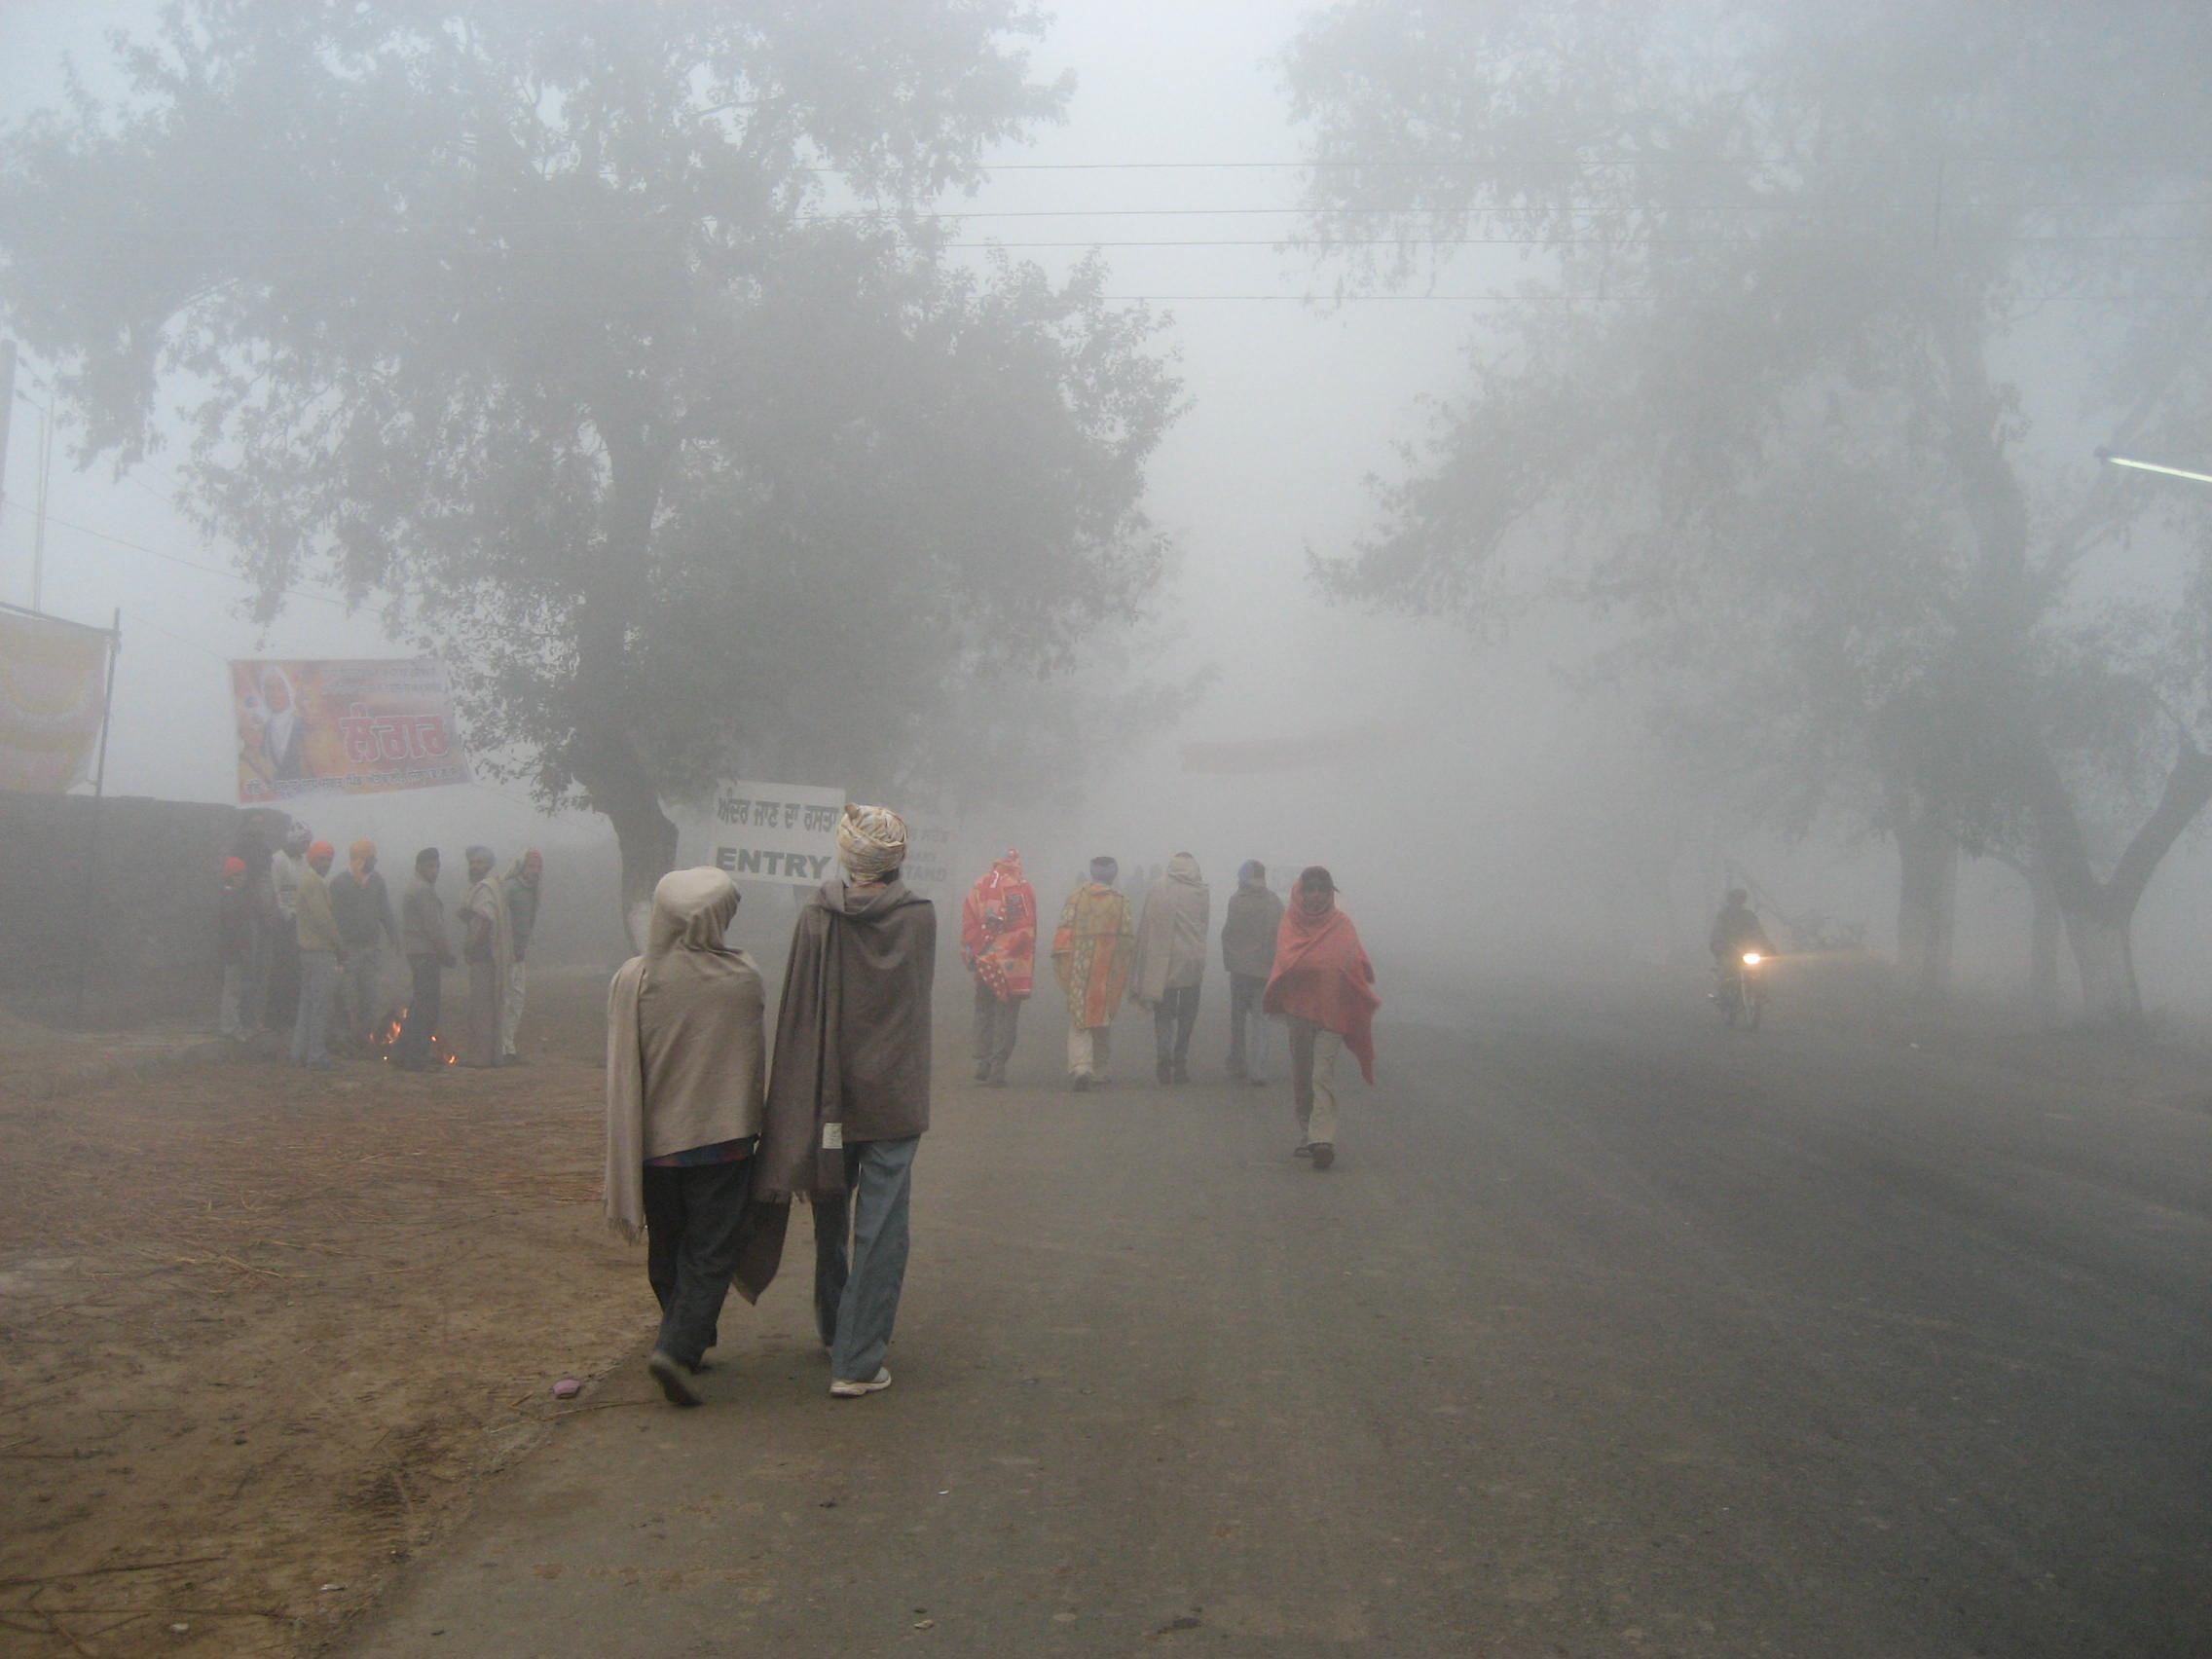
Poor visibility and no separate pathway for pedestrians

Slide 9
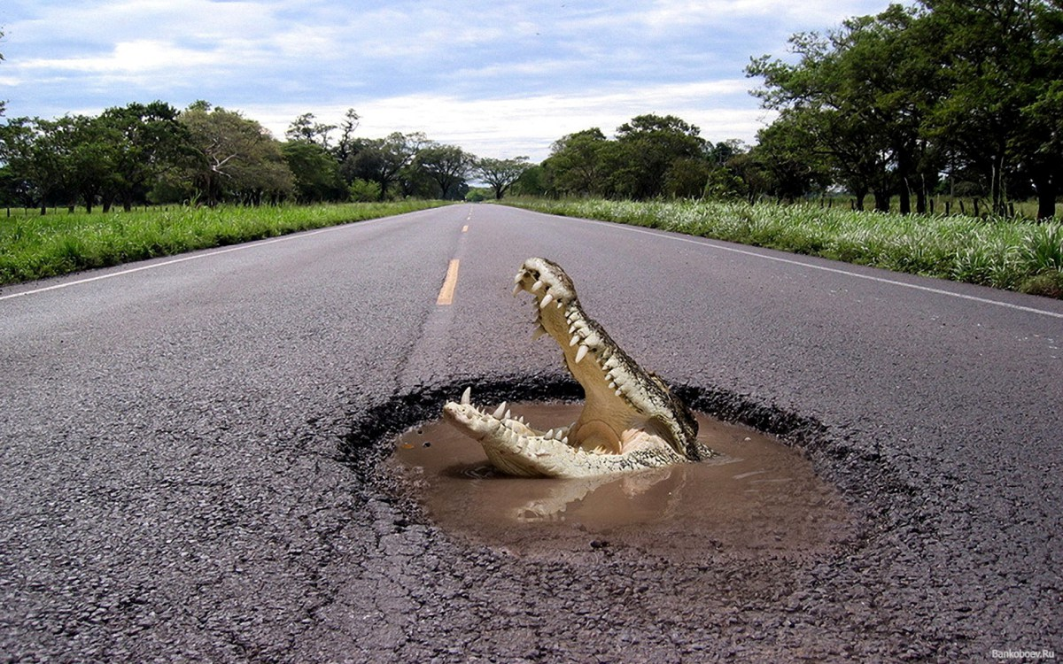
THE DEADLY JAW

Slide 10


Slide 11
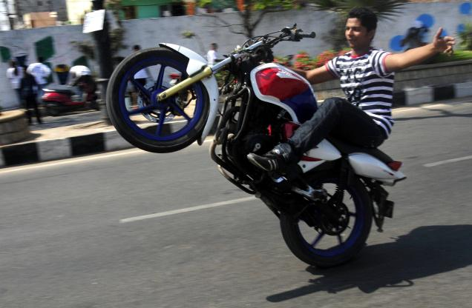
Road Traffic Accidents
The leading cause of death of young people aged
16-35 years
DANGEROUS ACROBATIC
A TWO-WHEELER IS NOT A TOY
Notes:
1.3 million deaths
20-50 million non-fatal injuries
Leading cause of death for people aged 15–29 years
Over 90% of road traffic deaths and injuries occur in LMI countries
1–3% of the gross national product
Only 15% of countries have comprehensive laws
Inadequate pre, acute & post crash care

Slide 12
Ten points of road safety
Awareness of traffic signs
A - Hand signals
B – Direction indicators
C – Lanes of the road

Slide 13
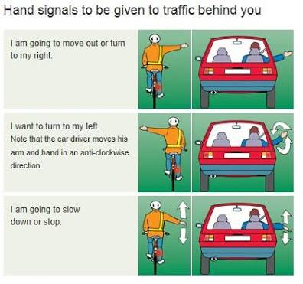
Hand signals-Avoid confusion and accidents
I am going to move out or turn to my Right
I want to turn to my left
I am going to slow down or stop

Slide 14
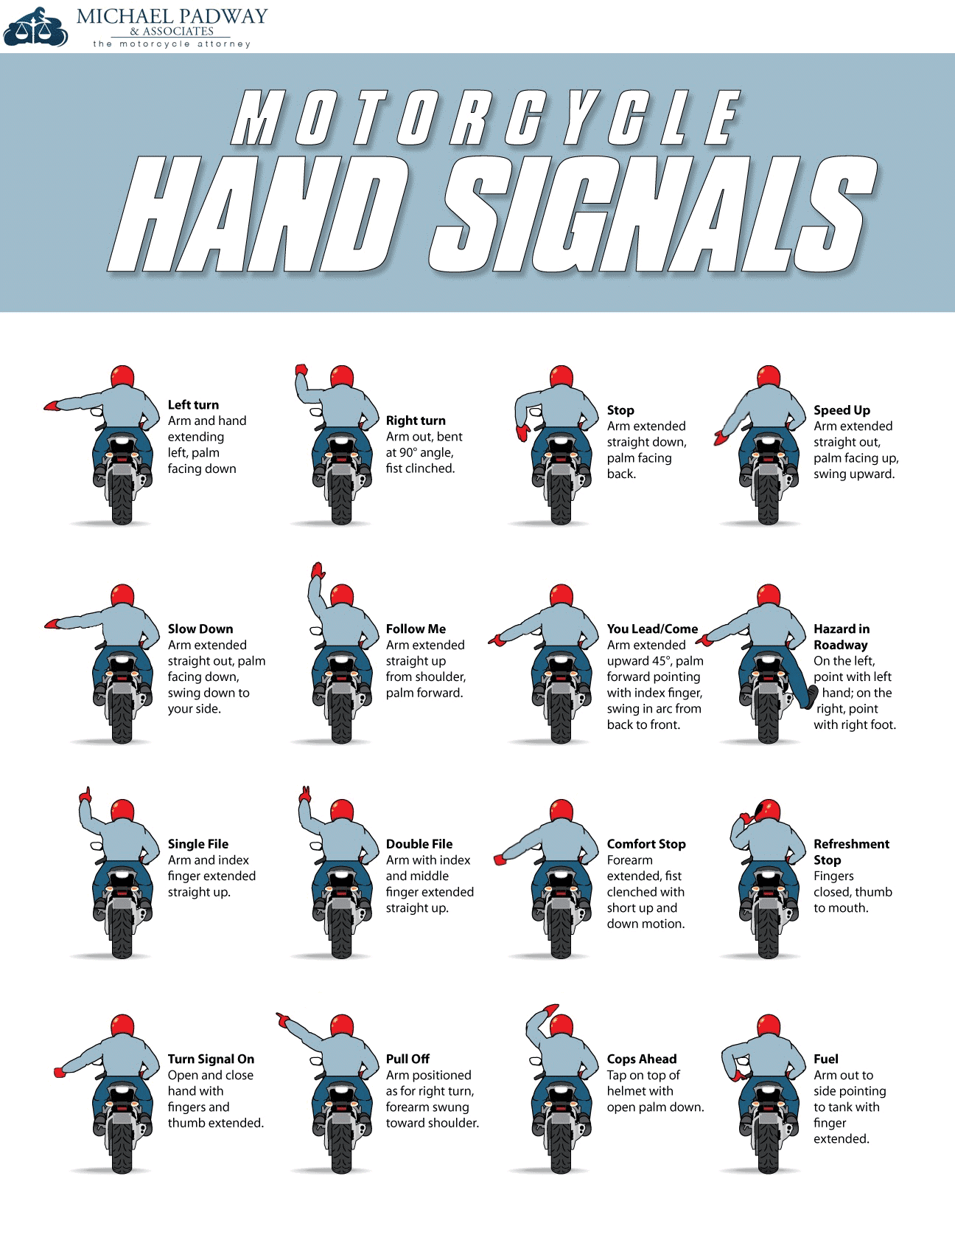

Slide 15
DIRECTION INDICATORS
It is traffic signs and signals at every cross road
Helps in darkness and alternative of hand signals
It has different color code and have different meanings

Slide 16

TRAFFIC SIGNALS
STOP AND DO NOT CROSS
GET PREPARED TO CROSS
SAFE TO CROSS THE INTERSECTION

Slide 17
LANE OF THE ROAD
1) TO STAY
Always use the left lane
2) TO OVERTAKE
Always use the right lane
3) USE HAND AND DIRECTION INDICATORS
Both to change lanes

Slide 18
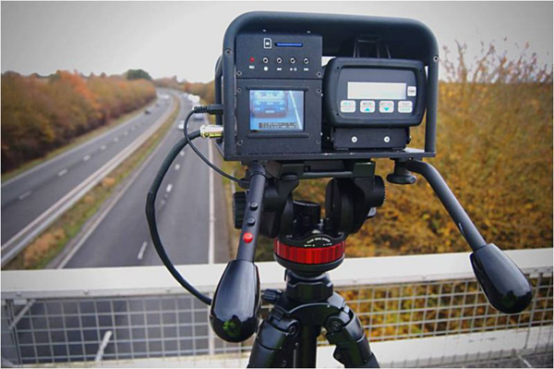
SPEED LIMIT
You should follow the speed limit to avoid accidents
Provision of speed witness radar
At every high traffic area and highway, there are
speed witness radar to control the traffic

Slide 19
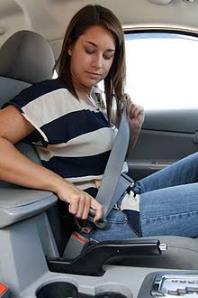

2.Wear your shields always
Seat belt on a four-wheeler
Helmet on a two-wheeler- it prevents you from head trauma.

Slide 20
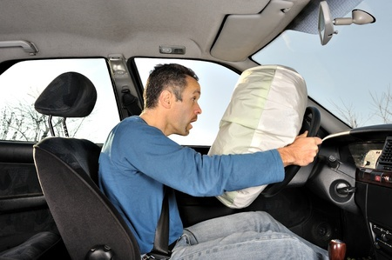
3. Seat belts and airbags
Wearing a seatbelt reduces the risk of death among front-seat passengers by 40−65% and among rear-seat occupants by 25−75%.

Slide 21

4. Motorcycle helmets
Wearing a good quality motorcycle helmet can reduce the risk of death by ±40% and severe head injury by >70%.

Slide 22
Awareness of hoarding
Hoarding of traffic rules at important routes will be made aware to common people
It creates a habit in people

Slide 23
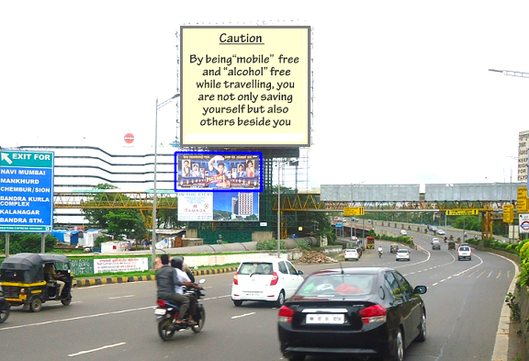

Slide 24
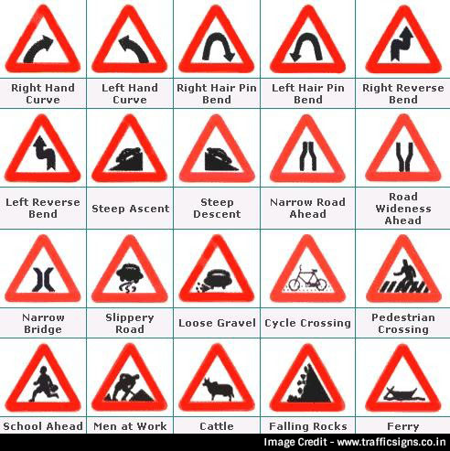

Slide 25
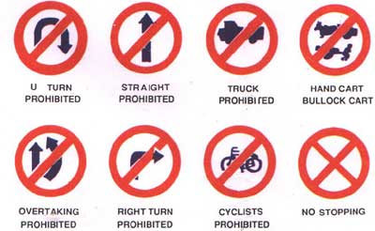

Slide 26
Maintenance of your vehicle
Check the condition of your vehicle before taking it on the road
Examples:
Check fuel
Wiper of glass
Air pressure in the Tyre.

Slide 27
Design features of the vehicle
Helps in reducing accidents
Examples of some safety features
Seatbelt
Airbags
Fog lamps
Anti glare glasses
Active headrest
Zone body.

Slide 28

Proper road maintenance and warning
Potholes on road in rainy season
Use fluorescent tape and other warning signs in accident prone area, school, bumps on the road and undergoing construction areas.

Slide 29
TIME MANAGEMENT
Make an early move to your destination
Don’t rush
Hurry will put you in danger as well as others on the road
Proper time management keeps you cool and calm.

Slide 30
Importance of road safety
It spreads awareness among the people
It prevents accidents and keeps you safe as well as others on the road
It prevents loss of family and society
It prevents penalties and loss of property.

Slide 31
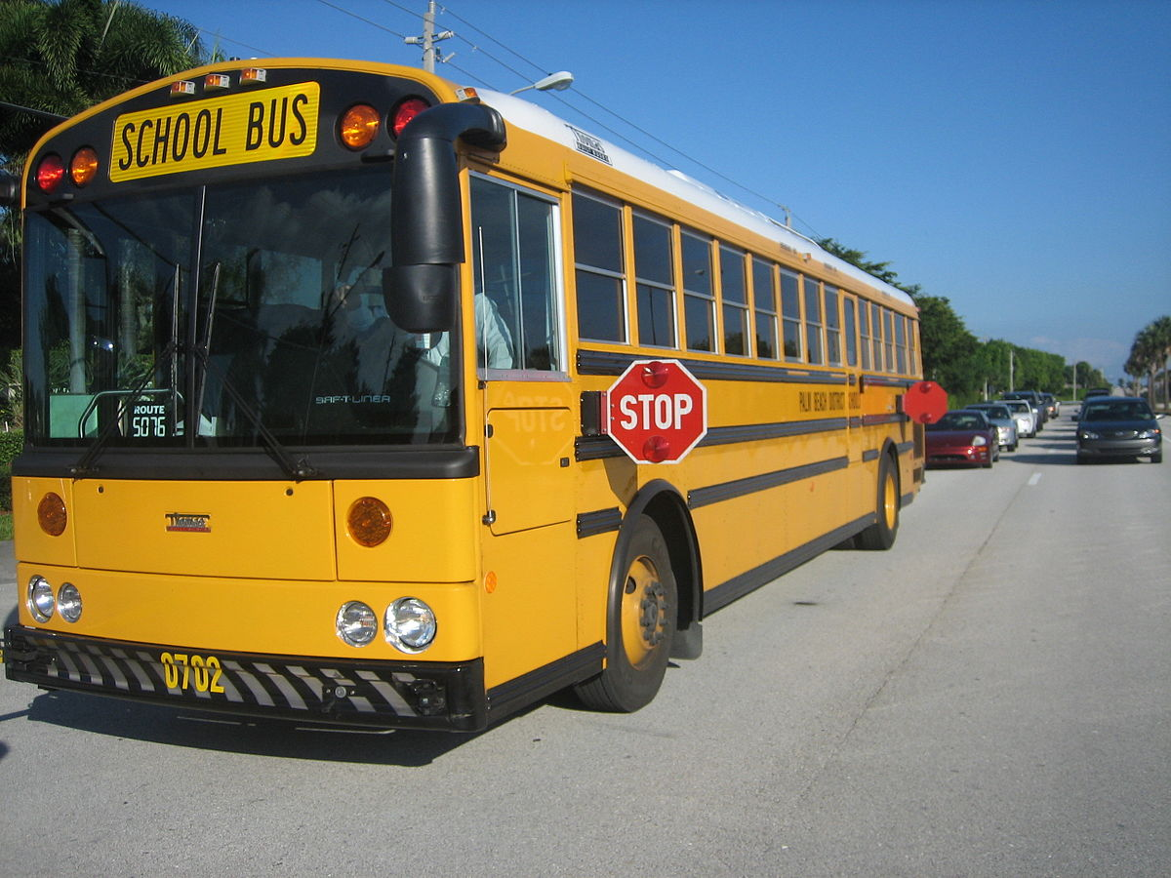
GUIDELINES FOR TRANSPORT FACILITIES IN SCHOOL
EXTERIOR OF THE BUS
Colour Yellow
“SCHOOL BUS" written back
and front
Hired bus “On School Duty ”
Should be clearly indicated.

Slide 32
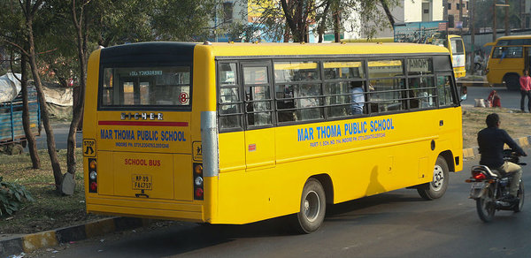
EXTERIOR OF THE BUS
D. Details of the driver (Name, Address, licence number, badge number)
E. School name and telephone no. must be written on the bus.

Slide 33
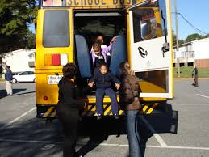
INTERIOR OF THE BUS
A. The windows must be fitted
with grills and mesh wire
B. The doors of the bus should
be fitted with reliable locks
C. Emergency exit doors are
installed in the School bus.

Slide 34
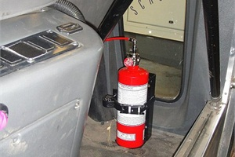
INTERIOR OF THE BUS
D. School cabs should be fitted with speed governors with a maximum speed limit of 40 KM/H
There must be a fire extinguisher in the bus.
F. GPS and CCTV are compulsory
in each school bus.

Slide 35

MANPOWER IN THE BUS
The driver should have a valid D.L. and a minimum of five years of experience driving H.V
There must be an attendant from the school on the bus.

Slide 36
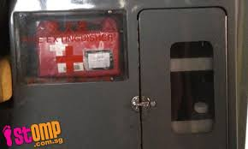
FACILITIES IN THE BUS
The bus must have a First-Aid-Box and drinking water.
To keep school bags safely, at a
convenient place inside the bus.
Buses shall be fitted with an alarm bell and a siren.
Sufficient white lighting inside the bus.
Buses should be visible from the outside.

Slide 37
PERMITS
Valid insurance, permit
Medical check-up.
The driver shall be dressed in
the uniform.
If the age of school children is
Below 12 years, the number
of children carried shall not
exceed 1½ times the permitted seating capacity.

Slide 38
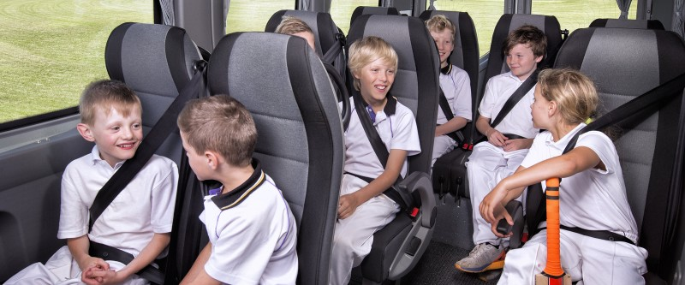

PERMITS
Children above 12 years shall be treated as one person
The school bus drivers are restricted from using mobile phones while driving the bus.

Slide 39
ABC OF ROAD SAFETY
A- Awareness : About traffic rules, from its danger and from other safety measures
B- Behavior : Habit to follow the traffic rules and safety measures to stay safe
C- Choice : How to make safety choice and help other stay safe too

Slide 40
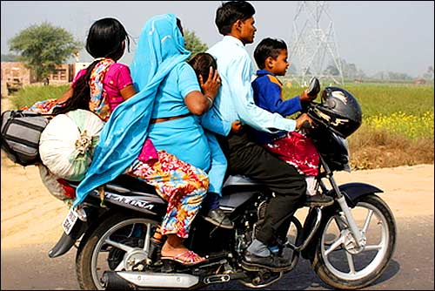
THE SAFE HELMET

Slide 41
A wise man learns
by the experience of others,
A fool
by his own!

Slide 42

HOME SAFETY
Notes:
Slide Show Notes
Today, we’re going to talk about home safety. You may think that your home is a very safe place compared to the workplace, but the fact is that many accidents happen in the home. And some of those accidents can be very serious—even fatal. So it’s important to think about home safety and make sure your home is as safe as it can be for you and for your family.

Slide 43


SAFETY BEGINS AT HOME

Slide 44

Why Talk About Home Safety?
  More serious injuries happen at home than
  on the job
  Precautions aren’t
  always taken
  Safety should
  be 24/7

Slide 45
FIRE SAFETY
  Wiring and appliances
  Fireplaces and stoves
  Furnace/electrical
  Kitchen
  Workshop
  Smoke detectors
Notes:
Slide Show Notes
Fire is a hazard that everyone must protect against in the home. A home fire is reported every 15 seconds in the United States. Eight out of 10 fire-related deaths occur in home fires.
Many home fires are caused by faulty wiring or problems with the furnace.
Fireplaces and woodburning stoves can also pose combustion hazards. Be sure to clean them properly and know and follow safe burning practices.
Make sure that electrical and furnace inspections, updates, and repairs are done by competent people.
Kitchens are another common source of home fires. Be extra careful while cooking. Keep towels and other combustible materials away from the range. Keep an eye on pots and pans, particularly if hot oil is involved. And make sure there’s a fully charged fire extinguisher in the kitchen that family members know how to operate.
Like the kitchen, the workshop and garage are other fire danger spots. Be careful when working with electrical power tools, and make sure you don’t overload circuits. Keep any products that contain flammable materials in tightly closed containers away from ignition and heat sources.
Also, make sure that you have working smoke detectors and carbon monoxide detectors on every floor of your home and near bedrooms. Test them monthly and replace batteries on a regular schedule.

Slide 46
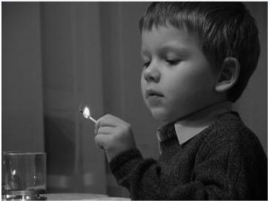

PLAYING WITH FIRE

Slide 47
HOME ESCAPE PLAN
  Don’t stop—just get out!
  Move quickly but calmly
  STOP, DROP,
  and ROLL
  Don’t open
  hot door
  Stay as low as
  possible
Notes:
Slide Show Notes
Every family should have a home escape plan that should be practiced regularly. Plan at least two ways to get out of every room in your home. If you live in a multiunit building, find out what emergency procedures are recommended. Designate a meeting place once you are outside. Teach family members to recognize the sound of the smoke alarm and follow these emergency procedures in the event of a home fire:
Don’t stop to get dressed or take things with you—just get out!
Move quickly but calmly to the nearest exit.
If clothes catch fire, STOP, DROP, and ROLL!
Don’t open a door that feels hot—try to get out another way.
Also, stay as low to the ground as possible to minimize smoke.

Slide 48
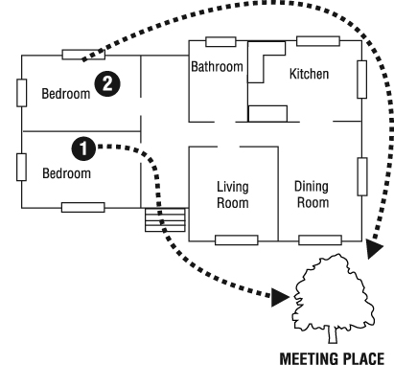
HOME ESCAPE PLAN (CONT.)
  Call 108/911 or the fire department from outside
  Go to the chosen
  meeting place
  Tell firefighters if
  pets are inside
Notes:
Slide Show Notes
Call 911 or the fire department from outside—for example, from a neighbor’s house.
Go to the chosen meeting place and stay there. Don’t go back into a burning house for any reason.
And, tell firefighters if there are pets inside, and they will try to rescue them if at all possible.
Be sure to conduct regular fire drills with the whole family.

Slide 49
SLIPS, TRIPS, AND FALLS
  Install grab bars and use bath mats
  Hold handrails
  Turn on lights
  Use ladders and
  step stools
  Slippery pavements
Notes:
Slide Show Notes
Slips, trips, and falls are another common home hazard. The most dangerous places are bathrooms, stairs, ladders, and slippery pavements outside the home. About one-third of accidental deaths around the home are caused by falls.
To prevent slips, trips, and falls in and around your home:
Install grab bars in showers and tubs and use bath mats to prevent slips and falls in bathrooms.
Hold onto the handrail going up and down the stairs.
Turn on a light before entering a dark room to avoid trip hazards.
Use ladders and step stools to reach high places, not chairs. We’ll talk more about ladder safety in the next slide.
And finally, salt or sand icy or slippery pavements outside your home.
A slip, trip, or fall could cause a back injury or even a broken bone. A fall from a ladder could be much more serious.
Think about potential slip, trip, and fall hazards around your home.
Lead a discussion about slip, trip, and fall hazards in the home.

Slide 50
ELECTRICAL SAFETY
  Don’t overload outlets
  Check cords/plugs routinely
  Don’t use faulty appliances
  Keep electricity away from water
© Business & Legal Reports, Inc. 1003
Notes:
Slide Show Notes
Electricity is something we take for granted in the home. We use it all the time. What could go wrong? Lots! Electricity can cause fires, shocks, and electrocution.
Make sure not to overload outlets; and if you have youngsters, use childproof outlet covers.
Check cords and plugs routinely to make sure they’re in good condition and never place them in an area where they need to be stepped on or over. Replace damaged cords or plugs. Also, make sure to use only extension cords with the UL-approved tag. And, only use extension cords designed for outdoors outside your home.
If you feel a shock from an appliance, or if it smells, smokes, or sparks, turn it off right away, unplug it, and don’t use it again until it is repaired.
Remember that water and electricity don’t mix. Keep electrical appliances and other electrical equipment away from water and dampness. Don’t touch anything electrical with wet hands or while standing in water or a damp spot. Also, dry sweaty hands before touching electrical appliances or plugs.

Slide 51
HAZARDOUS MATERIALS
  Always read labels
  Keep hazardous materials away from children
  Use caution with flammable substances
  Never mix household cleaning products.
Notes:
Slide Show Notes
If your household is like most people’s, it’s full of products than contain potentially hazardous materials. All kinds of cleansers, stain-removing solvents, pool chemicals, pesticides, gasoline or kerosene, and other products can be harmful to your family’s health if not used properly. Some are poisonous if swallowed. Other substances, such as gasoline and kerosene, can burn easily and rapidly, or even explode.
Always read the label for warnings and safe handling instructions before using any household product.
Keep cleaning products and other hazardous substances that contain hazardous ingredients out of the reach of children.
Keep flammable materials, such as gasoline, in properly labeled and tightly sealed containers away from heat and other ignition sources.
And finally, never mix household cleaning products. The combination of ingredients can release hazardous vapors or cause a dangerous reaction.
Think about the household products you have in your home. Have you read the labels on all these products to determine if there are any hazards and any precautions that should be taken when using them?
Ask trainees to identify some potentially hazardous substances they have in their homes.

Slide 52

HOME HAZARDS
In the previous slides, we identified
four basic home hazards:
Fires
Electricity
Slips, Trips,
And Falls
Hazardous
Materials
Notes:
Slide Show Notes
Let’s see how much you remember now about the home hazards we’ve mentioned in the previous slides. We identified four basic home hazards. Can you remember what they are?
Here are the answers. The four basic home hazards are:
Fires;
Slips, trips, and falls;
Electricity; and
Hazardous materials.
How did you do? Did you remember all four home hazards?

Slide 53



Drowning Prevention
  Keep pools fenced in
  Don’t let children
  swim alone
  Don’t leave a child unattended in the
  bathtub
  Install grab bars in bathtubs
Notes:
Slide Show Notes
Most drownings occur in the pool or in the bath. Usually, they involve unsupervised young children.
Remember these rules to prevent drowning:
Keep backyard pools secure with a fence and gate;
Do not allow children to swim without an adult in attendance who can swim;
Never leave a child under 5 years of age unattended in the bathtub; and
Install grab bars in bathtubs if you have an older or disabled person living with you.

Slide 54

HOLIDAY SAFETY
  Use fire-resistant decorations
  Keep away from heat sources
  Avoid lighted candles
  Use approved
  cords and lights
  Use only approved
  waterproof lights outside
Notes:
Slide Show Notes
Holidays are joyous times for most people. But they can also be a dangerous time at home. So don’t let your guard down during any holidays.
Make sure all decorations are made of fire-resistant materials.
Keep decorations clear of sources of heat or flame such as radiators, fireplaces, and candles.
Avoid lighted candles and turn off indoor holiday lights when you’re not home.
Keep natural Christmas trees moist—dry needles can catch fire. Trees need up to a gallon of water a day to keep fresh.
Don’t use a fireplace without a metal screen or glass doors in place, and don’t burn wrapping paper in the fireplace. Don’t leave discarded gift wrap near a fireplace, candles, or heat sources such as radiators.
Use only UL-approved extension cords and lights.
And finally, outdoors, use only lights and extension cords that are waterproof and approved for outdoor use.
Also avoid falls while decorating inside and out by using a ladder to reach high spots, being careful to hold on while up on the ladder.

Slide 55

FIREWORKS SAFETY
  Never use indoors or near dry grass
  Have water nearby
  Keep clear
  Read directions
  and warnings
  Supervise kids
Notes:
Slide Show Notes
Fourth of July and other summer holidays also raise safety concerns, and the issue is often fireworks. When fireworks are used, it doesn’t take much for a celebration to turn into a tragedy. Every year, hospital emergency rooms are full of adults and kids with burns and other horrible injuries caused by careless use of fireworks. To help prevent these accidents, remember these important safety pointers:
Never light fireworks indoors or near dry grass.
Always have a bucket of water and/or a fire extinguisher nearby.
Stand several feet away from lit fireworks. If a device does not go off, don’t stand over it to investigate. Douse it with water and dispose of it.
Always read the directions and warning labels on fireworks. If a device is not marked with the contents, directions, and a warning label, don’t light it.
And, supervise children around fireworks at all times. Never let young children handle any kind of firework, even sparklers, which get incredibly hot and can cause terrible burns.

Slide 56
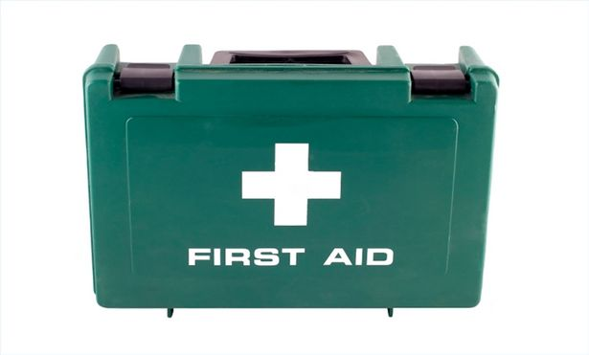
Have a useful first aid box at home and
Training in emergency response

Slide 57
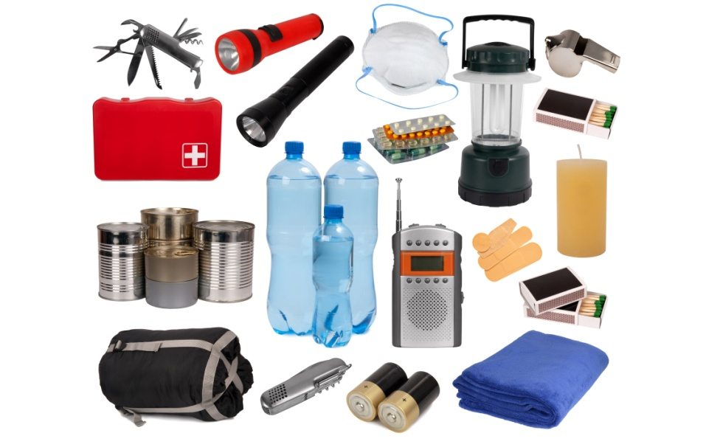
Emergency kit
Always ready
At home

Slide 58

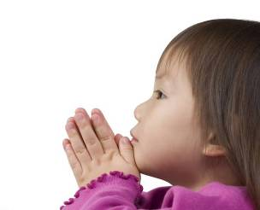
Make sure your child has a safe, secure environment at home.

Slide 59
REVIEW
Do you understand:
Importance of road safety
Ten points of road safety
ABC of road safety
  Fire safety?
  Preventing slips, trips, and falls?
  Electrical safety?
  Hazardous materials?
  Emergency kit?

Slide 60
EVALUATION
True or False?
Household cleansers and other chemical products pose no safety or health risks.
Notes:
Slide Show Notes
Before we begin the session, let’s take a few minutes to see how much you already know about home safety. Decide whether each statement on the screen is true or false. [PAUSE]
Now, let’s go over the answers:
More accidents happen off the job than on the job—This is true.
You should have a home escape plan and practice it with your family—This is also true.
Most home fires involving gas grills are caused by unattended cooking—This is false.
And finally, household cleansers and other chemical products pose no safety or health risks—This is also false.
How did you do? Did you get all the answers right?
If not, don’t worry. You’ll learn all about these issues and a lot more during the session.

Slide 61


THANK YOU

