Slide 1
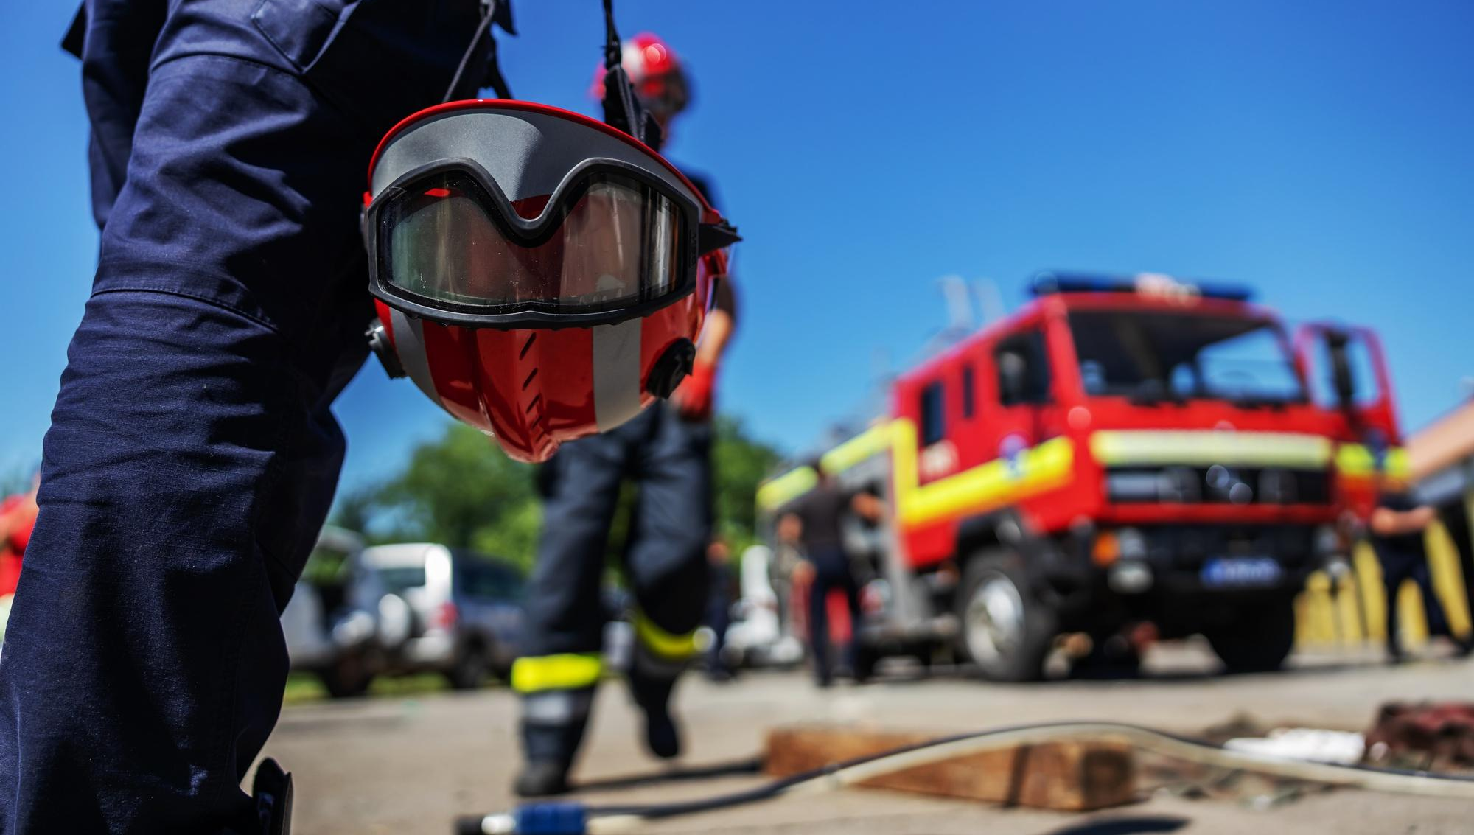



SDMC & Role of School Safety Team
Presented by:- Amit Kumar, AC

Slide 2


OBJECTIVES
At the end of this session, you will be able to know about….
Preparation of School DM plans.
Composition, role and responsibility of school safety teams.
Phases of drill.

Slide 3
Preparation of School DM plans
Schools to prepare DM plans based on the hazards to which they are vulnerable.
Sensitisation meeting for awareness of Teachers, School Management and students.
Formation of School Disaster Management Committee(SDMC).

Slide 4


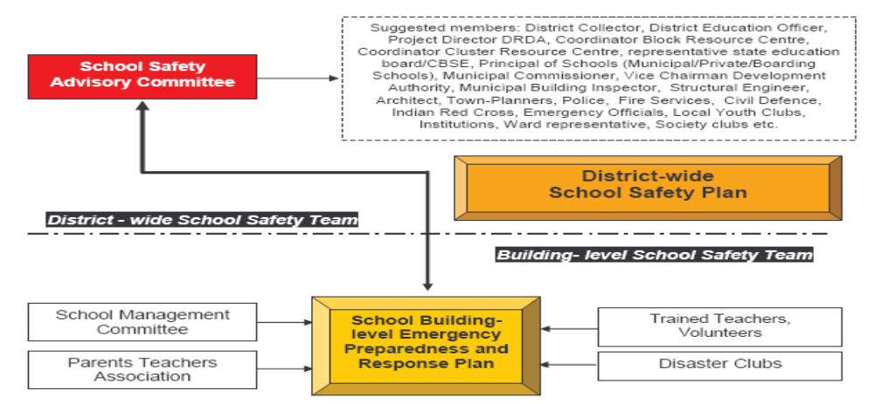

Slide 5

Suggested Composition)
Chairperson - Principal
Members - Vice Principal, Heads of Primary & Middle Schools
- Zonal Education Officer.
- PTA President.
- 1-2 parents (one lady)
- 4 students
- Representative from District DM
- Representative from closest Fire
Station
STAGE ONE – Formation of SDMC

Slide 6
Suggested Composition
- Representative of the closest Police Station
- Representative of Health Department
- Representative of Civil Defence
- Administrative Officer from School Office
- Disaster Management Expert ex ex-national, state or district authority.
- RWA representative
- Local NGO
- Local Doctor(s)
- Any others

Slide 7
Roles & Responsibilities
    Help the school in preparation & evaluation of DM Plan
    Look into the structural safety of the school
    Work out financial aspects of preparedness & mitigation measures.
    Arrange conduct of Mock Exercises on various types of disasters twice a year.
    During a disaster, help in coordinating various groups and teams

Slide 8
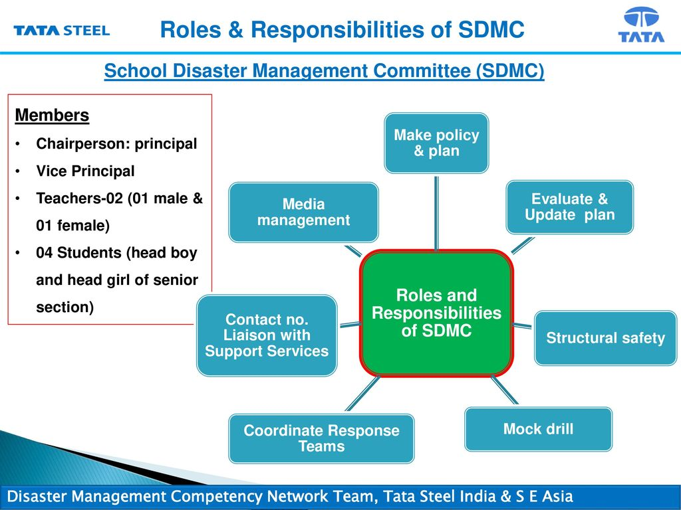

Slide 9
Major activities of SDMC
  Identification of Hazards and Safety and Vulnerability Assessment.
  Development of the School Safety Plan including
    Preparation of the school map
    Floor plans
    Organisation charts
    Details of children and their guardians
    Creation of an inventory of both the school's resources and the local resources.

Slide 10

Disaster Awareness Team
Awareness Group
Warning and Information Dissimination Team
Activity and Event Organising Team
School Disaster Management Committee
Evacuation Team
Search and Rescue Team
First Aid Team
Response Group
Site Security Team
Principal
(Chief of SDMC)
Fire Safety Team
Bus Safety Team

Slide 11
STAGE TWO – HAZARD IDENTIFICATION &
SAFETY ASSESSMENT
Chemistry laboratories:- Bottles used for storing chemicals not secured or protected against shattering..
Area having flammable liquids.
Hostel kitchen area
Number of children in each class who are physically challenged.
Main switch boards & hanging wires.
Number of hydrants/Taps in school.
Vulnerable classrooms.

Slide 12
Resources Inventory in School
Skilled human resources (first aid, rescue and evacuation).
Stretchers, fire extinguishers, ladders, ropes, torches, hailers, communication system, first aid box, lifesaving medicines, dedicated vehicle/s etc.
Nearest hospitals & their telephone numbers.
Inventory of rooms in school, open area for assembly after evacuation & open verandah.

Slide 13
STAGE THREE – SCHOOL DM PLAN
Playground
School canteen
Laboratories & Library
Class rooms in the school building
Social mapping

Slide 14

Generators
Fire extinguishers
School Buses
Human resources
Vulnerability/ Risk Map
RESOURCE MAP OF SCHOOL
Stretchers
Health Centre
Physically challenged
Play ground
Drinking water

Slide 15
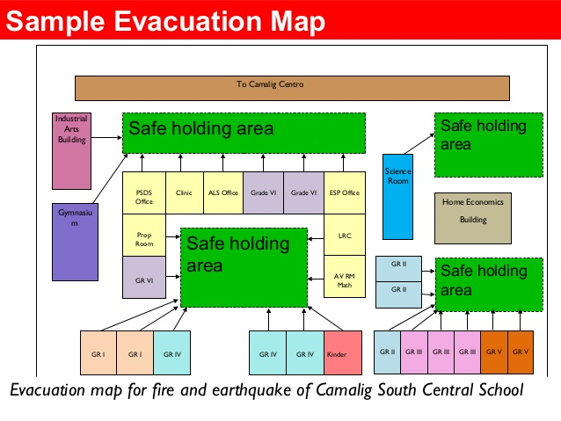

Slide 16
School DM Plan
Identification of safe places in the school
Senior section
Alternative staircases/ routes to be identified
Safe and alternate route Mapping

Slide 17
STAGE : IV
DISASTER MANAGEMENT TEAMS
Disaster Awareness Group
(Before Disaster)

Slide 18
Disaster Awareness Team
Composition
Teacher in charge of Disaster Management.
Art & Craft Teacher.
Drama & Music Teacher.
1-2 parents (working with media/NGO)
1-2 students (good speaker & creative).

Slide 19
Disaster Awareness Team
Roles
Obtain IEC materials posters, pamphlets, simple tips on do's and don'ts in different disasters, street plays and "nukkad nataks".
Conduct awareness generation activities systematically in the whole school, targeting different classes and also staff and teachers.
Organise demonstrations.
The school can organise - artwork: posters, bulletin boards, exhibitions, wallpaper, cards, bookmarks, creative writing competitions, essays, poetry, slogans.

Slide 20

Composition
Disaster management teacher
Art and Craft teacher, Music teacher
Prefects/ active students
Roles
Organising road show/ cycle rally
Drawing competition on a disaster situation.
Quiz competition
Mock Drills/ simulation exercise.
Cultural programmes
ACTIVITY/EVENT ORGANISING TEAM

Slide 21
Composition
Computer Teacher
Geography Teacher
Teacher with an electronic background.
1-2 parents (working with IMD, CWC)
4-6 students ( who can operate VHF sets).
Warning & Information Dissemination Team

Slide 22
Warning & Information Dissemination Team
Roles & Responsibility
Monitor & take regular updates from TV/Radio/Internet
Inform management/principal of any disaster/ emerging disaster situation.
Disseminate information on the main Notice Board and circulate in classrooms

Slide 23
DISASTER RESPONSE GROUPS
Evacuation Team
Composition
All class teachers.
Class monitors & hall monitor.
Prefects.
Roles
Duck, cover & hold at the first sign of an earthquake.
Evacuate in an orderly manner, in buddy system, with the monitor leading & teacher bringing the last buddies along the designated evacuation route.

Slide 24
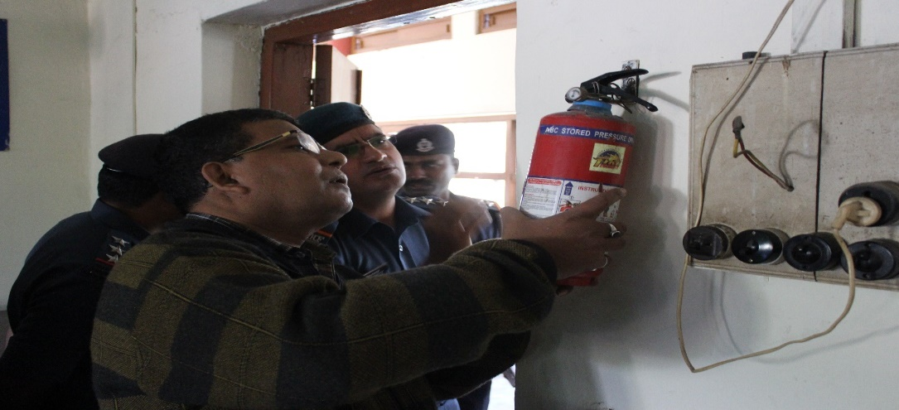
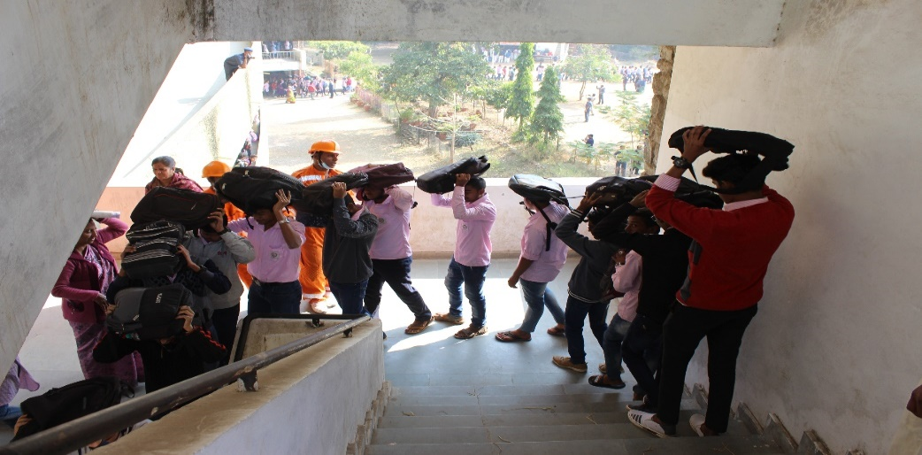
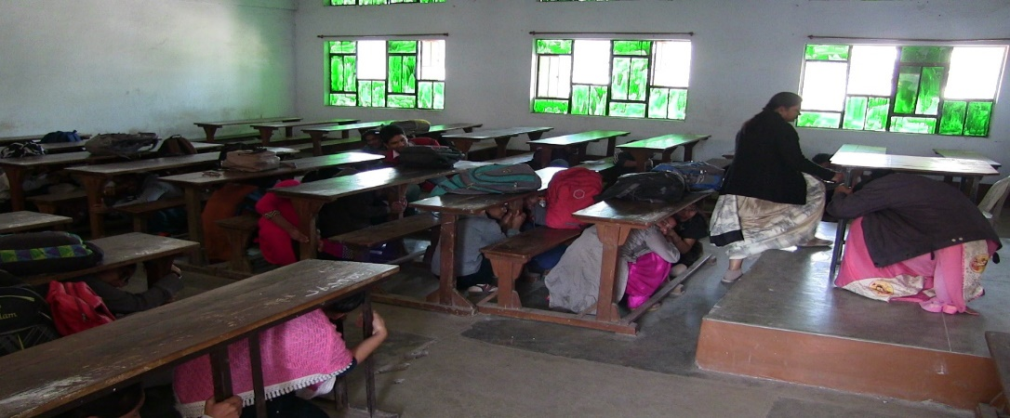
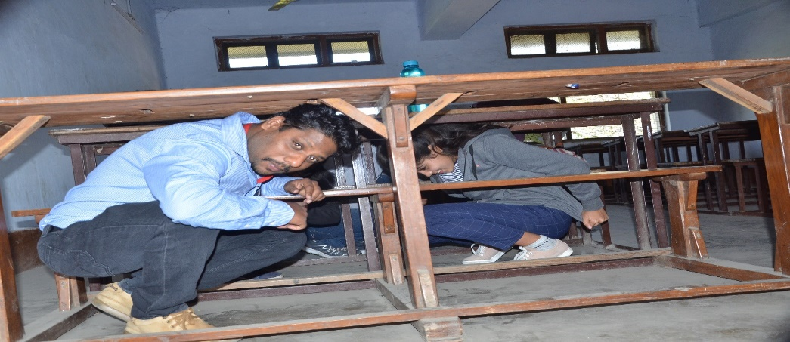

Slide 25
Search & Rescue Team
Composition
Sports/PT teacher
NCC/NSS/Scouts & Guides Teacher.
Fire Services representative
CD Trainer.
1-2 parents (from uniformed forces)
Able-bodied students
Roles & Responsibility
Check every room in the building (visually & physically)
Start search and rescue
Report the location of the injured to the first aid team,
Look for obvious structural problems/damages as a sweep made through buildings/floors and report to the Administrator/person responsible.

Slide 26
Composition
School doctor.
School Nurse.
St. John/Red Cross volunteers.
Civil Defence Volunteers.
1-2 parents (doctors)
Students trained in first aid/ who have taken biology.
Roles & Responsibility
Administer first aid and record all cases & treatment.
Accompany search & rescue teams during search.
Help in evacuating seriously injured.
Aid the physically handicapped.
First Aid Team

Slide 27
Composition
Teachers (2)
1-2 parents (from fire services/ Defence/
Para Military services/Civil Defence)
Students
Roles & Responsibility
Make sure fire extinguishers are in working condition.
Look for condition which may cause a fire.
Extinguish fire, if it occurs.
Switch off electric main switches and gas connections in case of emergency.
Fire safety Team

Slide 28
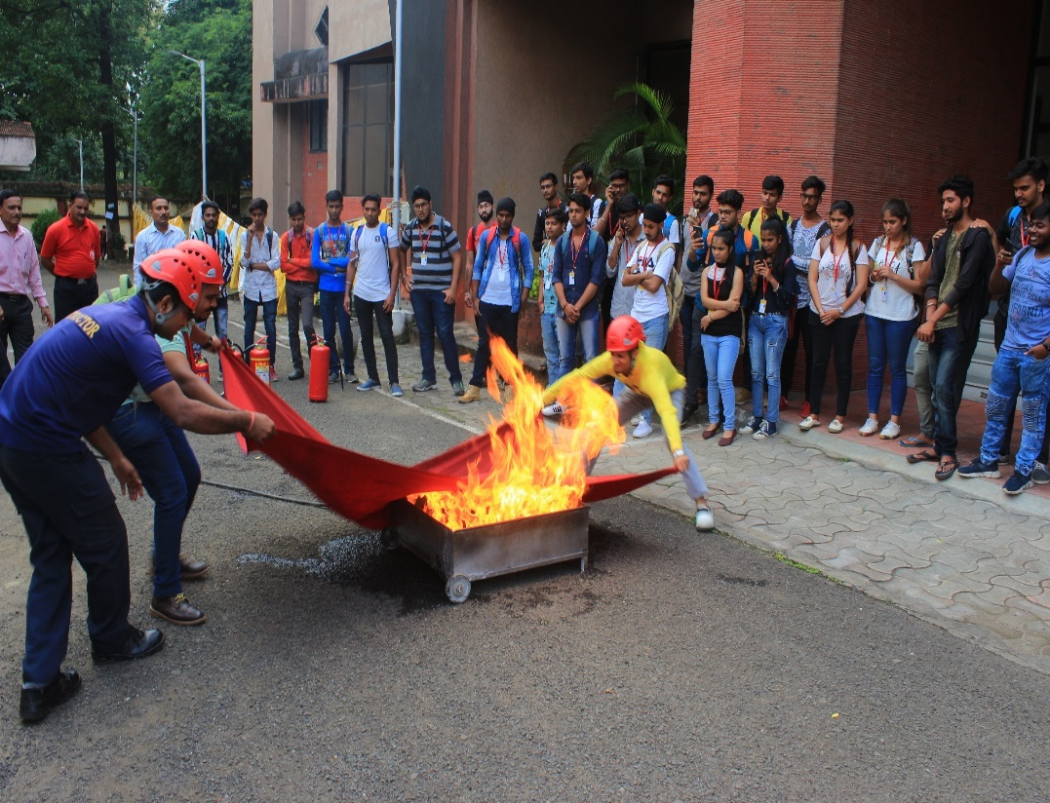
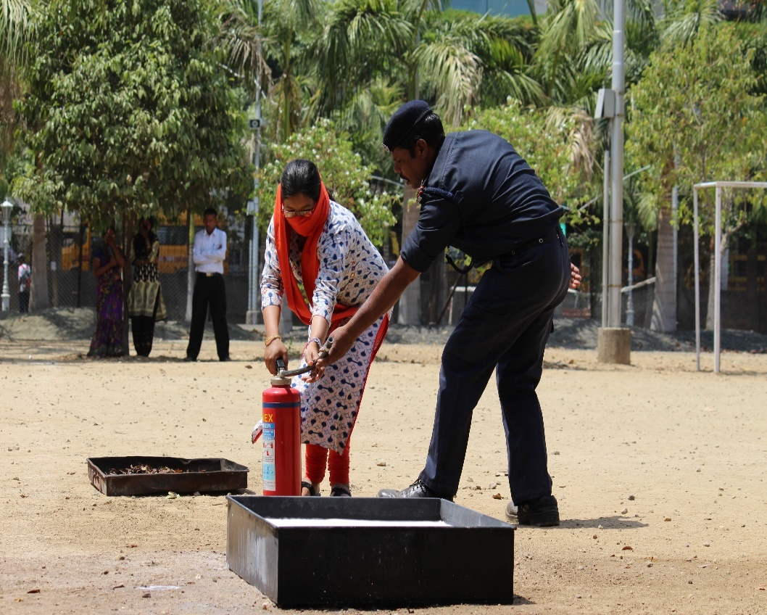
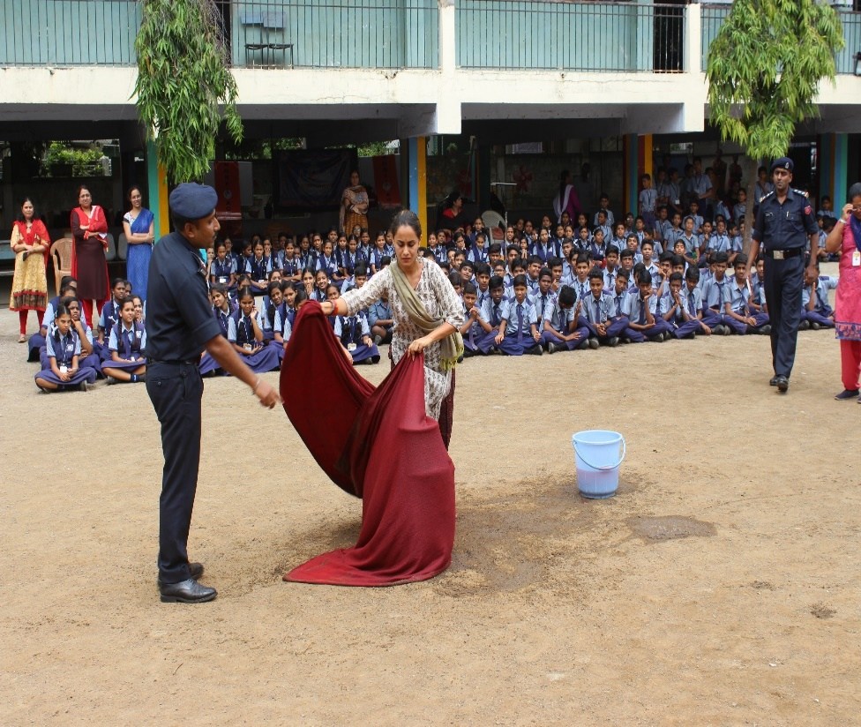

Slide 29
Composition
School security staff
Teacher (1 number)
Students (2 numbers)
Roles & Responsibility
Control entry/ Exit point.
Crowd control
Control over students
Control traffic flow on the campus.
Site Security Team

Slide 30
Bus Safety Team (Each bus)
Composition
Teacher (travelling in respective buses).
Student getting down at last stop.
One of the senior-most students in bus.
Roles & Responsibility
Pull over to the side of the road, if possible in open.
Instruct passengers to crouch down between seats and until shaking stops, move out and stay till contact with the DM department/school authorities.
Ensure special needs students are assisted.
Assist in giving first aid to injured students.
Establish communication with the school Control Room

Slide 31
Training of School Disaster Management Teams
First aid
Fire fighting
Search & rescue
Trauma counseling

Slide 32
PLAN UPDATION
Plans to be updated every six months
Plan to be approved by the Disaster Management Committee

Slide 33
PHASES OF DRILL
Phase 1: Alarm
Earthquake shaking warning is given for one minute.
This will be a pre-arranged signal such as siren/bell, which is known to whole school.
Phase 2 : Response
Duck, cover, hold & other response actions will be performed in classrooms.
If outside, go away from tall buildings

Slide 34
Phase 3 : Evacuation
Once the “shaking” warning signal stops, teachers and students should Check the building damage and take decision to evacuate the building following proper evacuation procedures or if building is damaged stay in the building.
Phase 4: Assembly
Whole school Staff /teachers/ students will assemble as per their class at the pre-determined assembly point.

Slide 35
Phase 5: Exercise by the search & rescue team
The search and rescue team will conduct the exercise in the school and rescue all possible approaches to students
Phase 6: First aid
First aid will be given by the medical team and as per the available medical kit.

Slide 36
Phase 7: Head Count
Teachers will take the attendance and check with the daily attendance sheet.
Make a list of absentees and activate the search and rescue team /first aid team
Phase 8: Evaluation
An evaluation of the drill must be conducted to identify problems encountered during the drill and how these can be corrected in future earthquake drills.

Slide 37
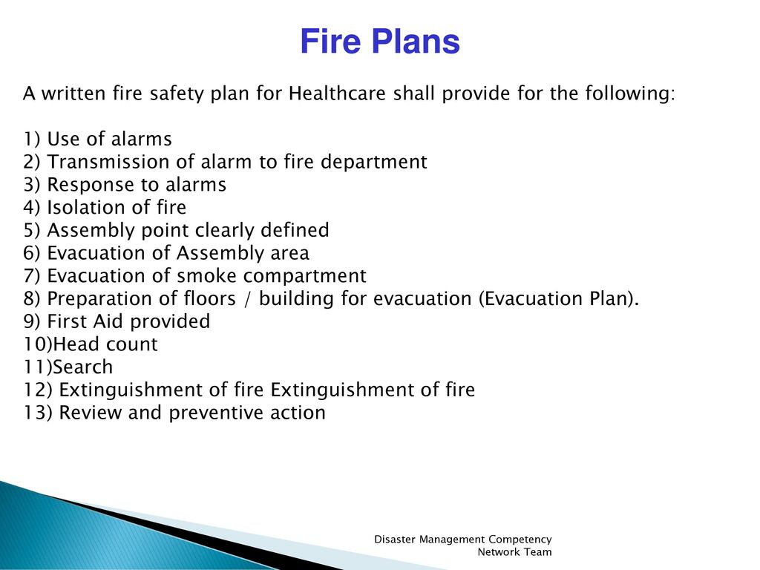
FIRE PLAN DRILL

Slide 38
PRECAUTIONS
Display the Dos & Don'ts and Evacuation Plan of your school building with safe and unsafe places.
Every class must be oriented & a movie on mock drill should be shown.
Observers should be located at dangerous places to prevent any injury
All Students & staff members must be aware of the assembly point & warning sign for drills.
Each classroom should be checked for damaged benches & other furniture which may harm students during drill.

Slide 39
PRECAUTIONS
Identify the safe & danger zone in school & find out the solution for the danger zone.
Explain the evacuation plan to students, teachers & other staff of the school
Give specific instructions on what to do during an earthquake e.g., Duck, Cover & Hold.
Give specific instructions about what to do as soon as the shaking stops e.g., don’t run, walk fast.
Inform students & teachers about the evacuation route & assembly point.

Slide 40
(Know your Risks & Environment)
HAZARD
RISK
ANALYSIS
VULNERABILITY
CONCLUSION
Be prepared for any natural or human-made disaster, climate change impacts.
Build Capacity – Individual, Family, Neighbourhood, Community, Institutions, work Place etc.
Plan actions systematically

Slide 41
Share what you learn and experience – Don’t allow mistakes to repeat
Protect life and livelihood
Be sensitive to the environment
Manage natural resources diligently
Improve Governance
Promote inclusive growth
CONCLUSION

Slide 42
REVIEW
Preparation of School DM Plans.
Composition, role and responsibility of school safety teams.
Phases of drill.

Slide 43
ANY QUESTION?

Slide 44
Evaluation
How many teams are in the Disaster Response Group?

Slide 45


THANK YOU

