Slide 1
STARFISH SIDE SCAN SONAR
IMAGING SYSTEM
Presented by:- Vimal Bounthiyal , 2IC

Slide 2
Objectives
Upon completion of this lesson, you will be able to learn about:-
State the starfish introduction and special features.
State different versions and star fish components/ accessories.
List the system configuration.

Slide 3
Introduction
Star fish imaging system is a side scan “SONAR” system. (Sound Navigation And Ranging)
Side-Scan SONAR send fan- shaped pulses of acoustic energy into the water and record the echoes they receive back to produce an image of the submerged objects.

Slide 4
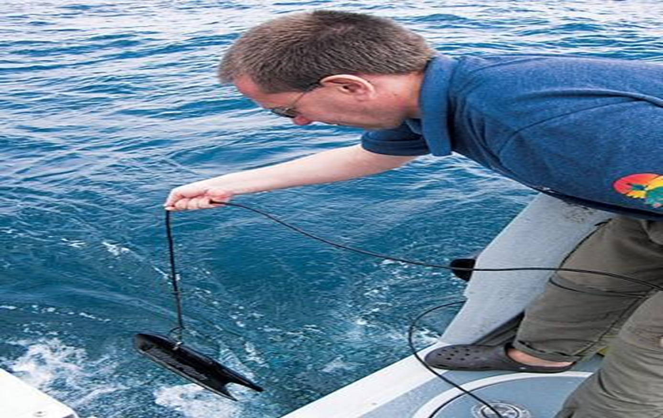
Starfish imaging system

Slide 5
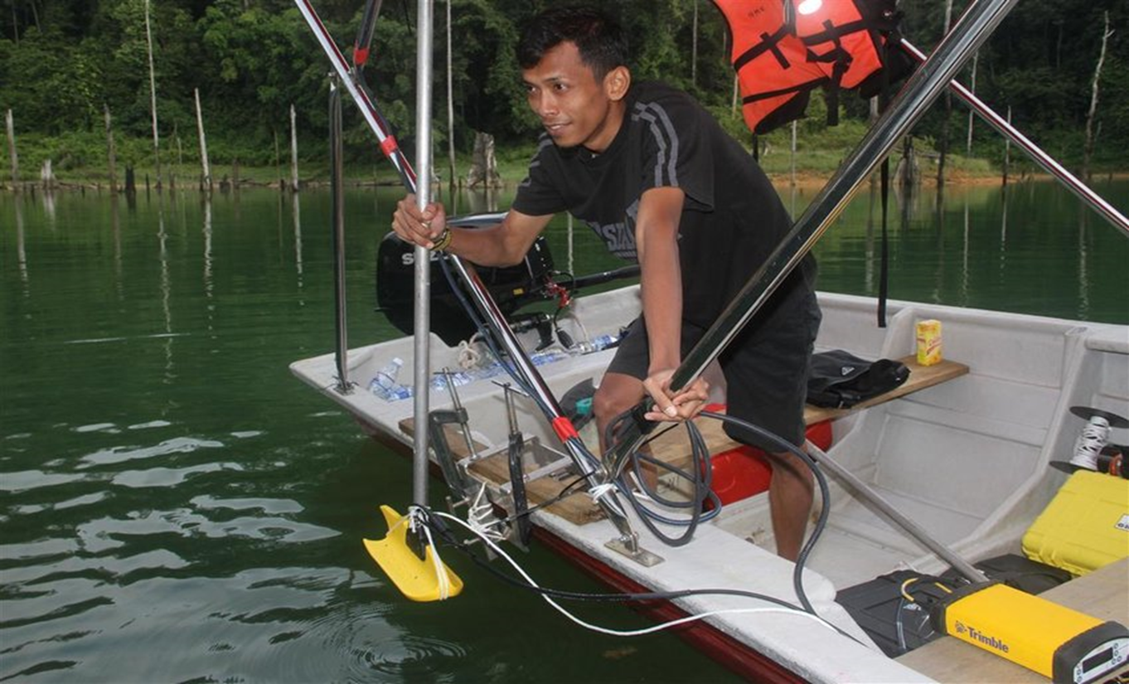
Starfish side scan sonar

Slide 6
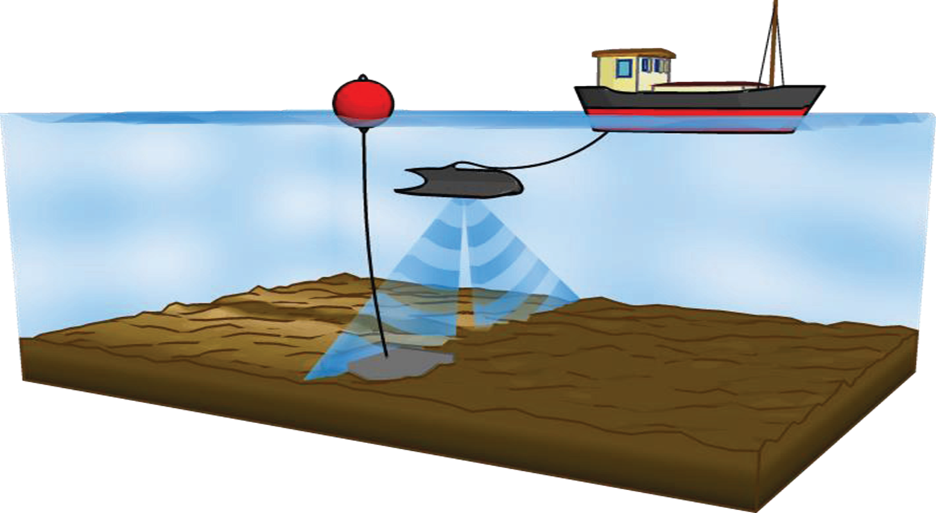
Search ops under progress

Slide 7
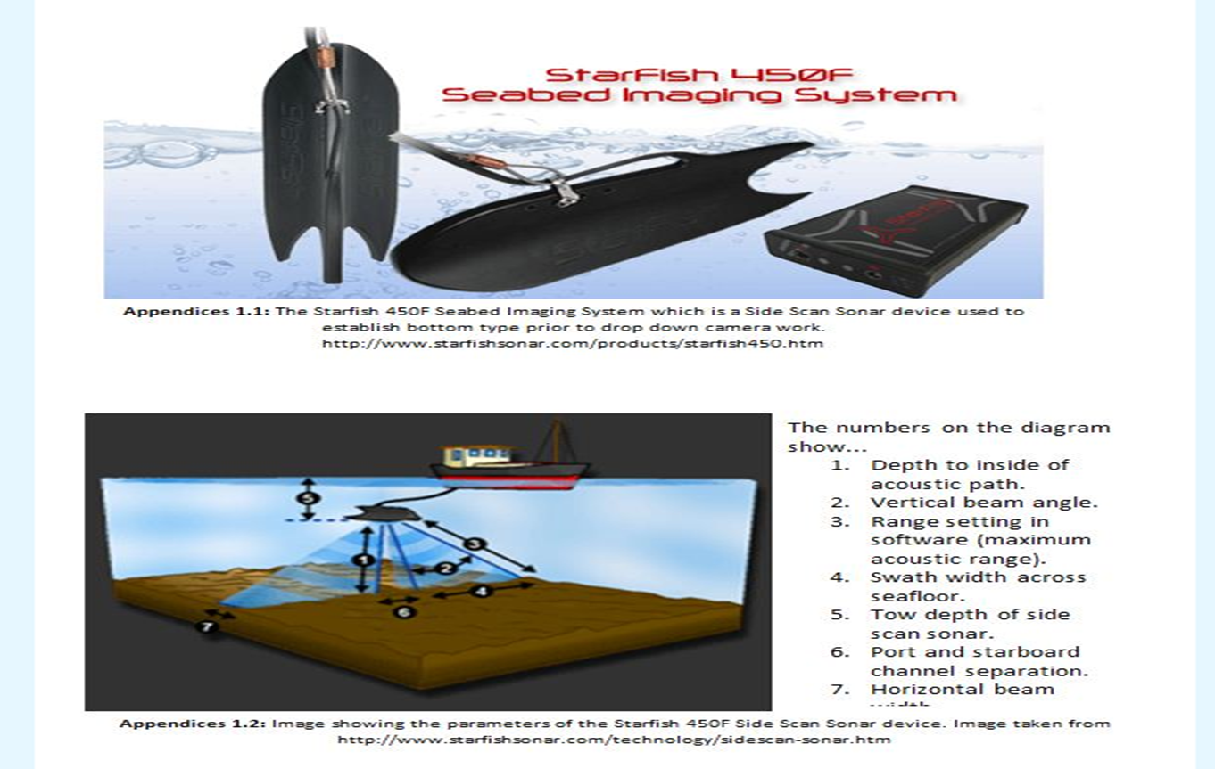
Starfish imaging system

Slide 8
FEATURES
Towable powerful side scan “SONAR” with good, clear image definition, small in size
Photographic quality image
Plug and play technology (USB interface to any PC)
Advanced and innovative design
Compact, rugged and portable
Easily transportable

Slide 9
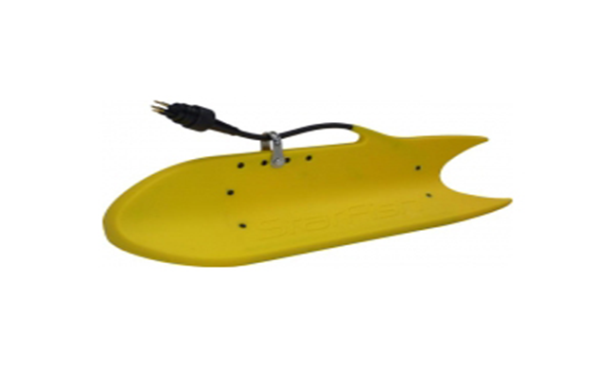
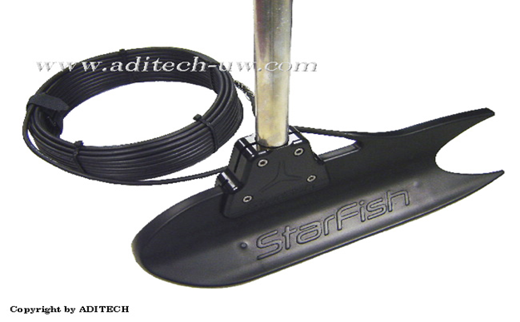
Starfish features
Starfish has two channels (a port channel and starboard channel) which contains a transmitters and receiver(transducer) and are mounted inside the fins of transducer head.

Slide 10
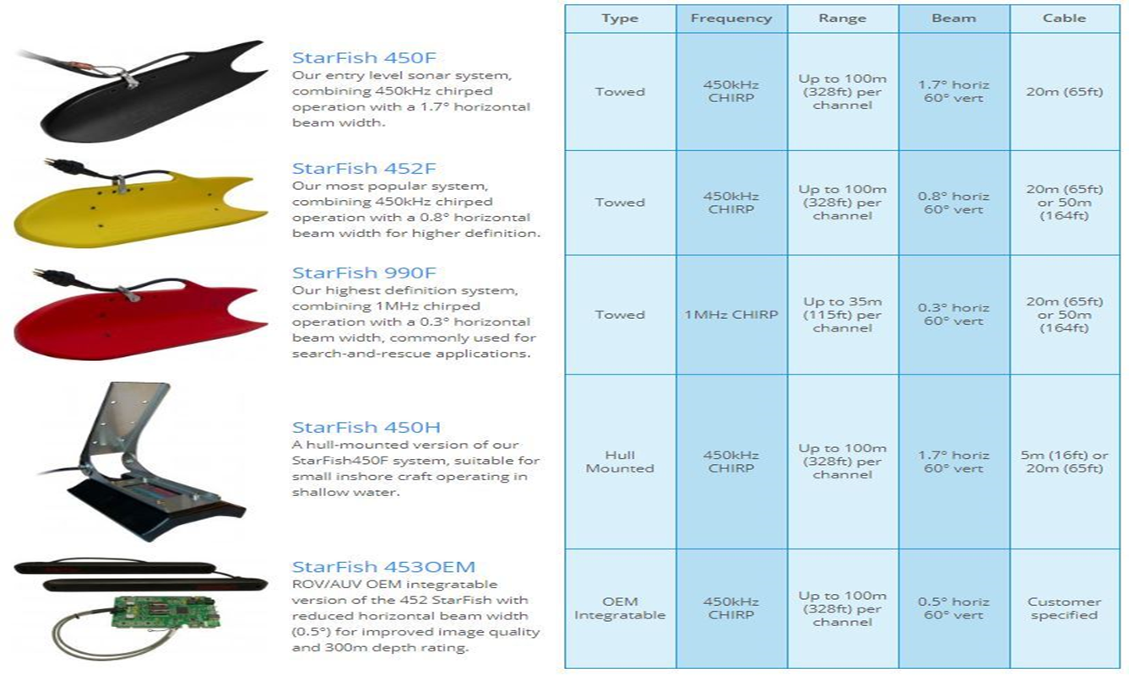
Various versions of starfish

Slide 11
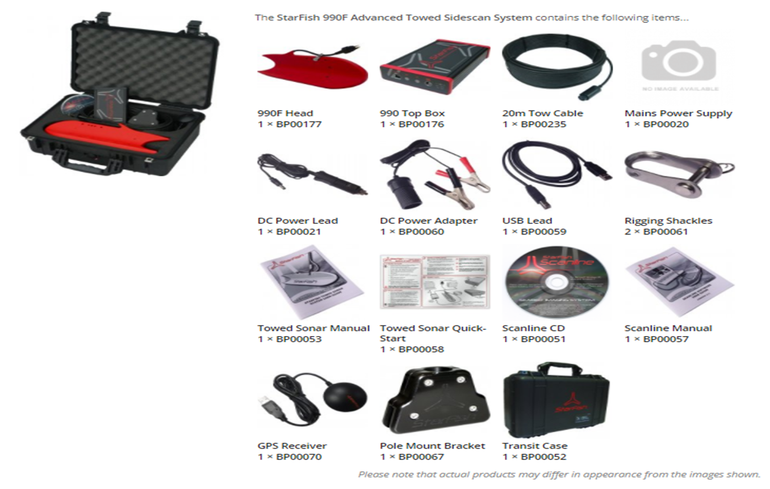
Starfish components

Slide 12
Starfish components & Accessories
Starfish head
Top box
20 mtr Tow cable
GPS receiver
Pole mounted bracket
Transducer Rigging shackles
USB lead
DC power Adapter
DC power lead

Slide 13
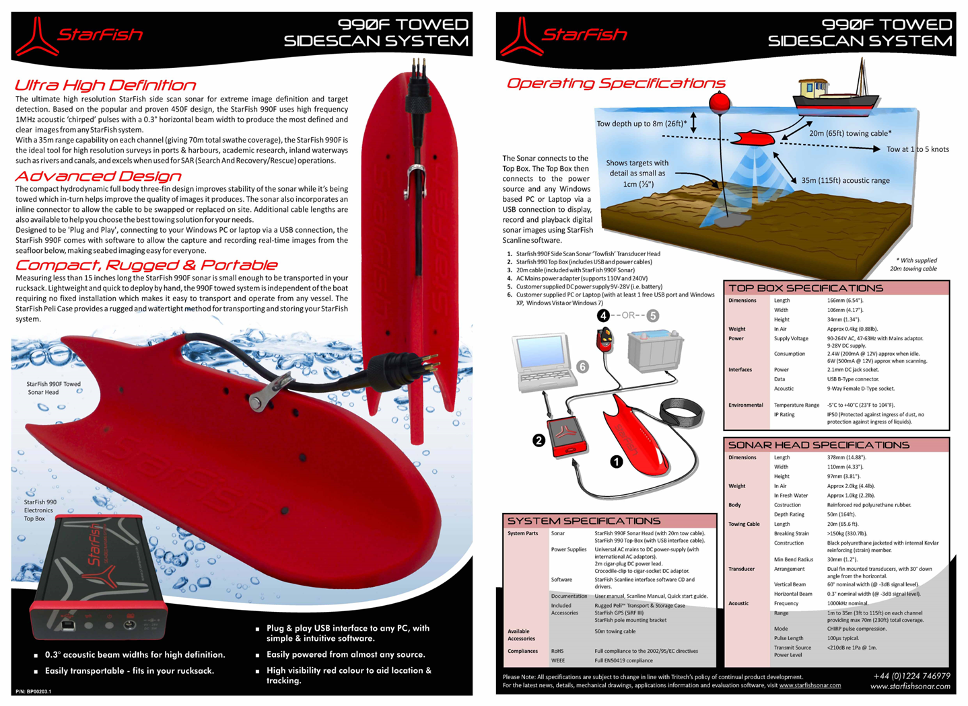

Slide 14
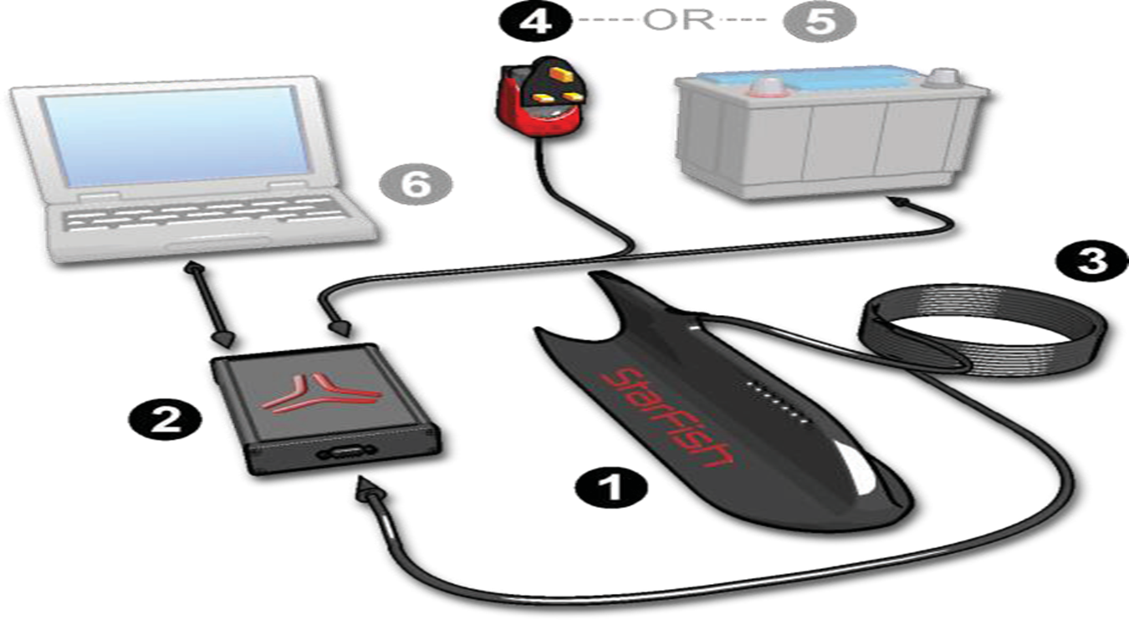
System configuration

Slide 15
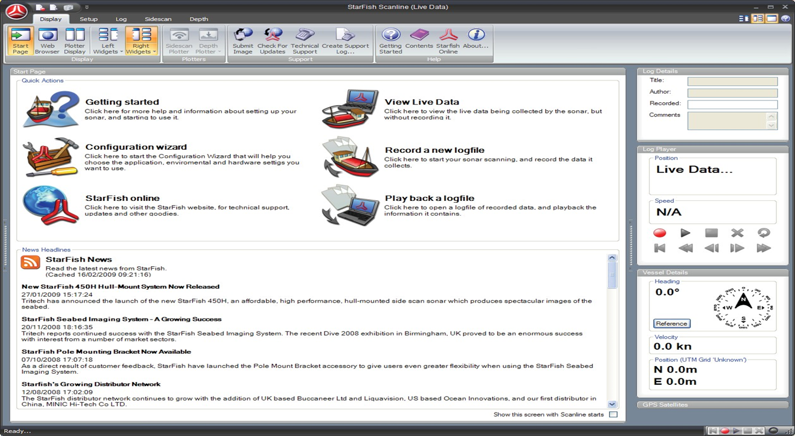
Monitor display

Slide 16
Review
After completion of this lesson, you are now able to.
State the starfish introduction and special features.
State different versions and star fish components/ accessories.
List the system configuration.

Slide 17
ANY QUESTION ?

Slide 18
Evaluation
Question1 –what is full form of SONAR system?
Ans - Sound Navigation And Ranging system.
Question2 –How sonar system work?
Ans -It send fan- shaped pulses of acoustic energy into the water and record the echoes they receive back to produce an image of the submerged objects.

Slide 19


THANK YOU

